Slide 1

Year 10 Information Evening
Croeso/Welcome

Slide 2
Purpose of the Evening
To introduce you to the Key Staff.
To make sure that families are clear about the GCSE & vocational qualifications being studied during Key Stage 4 and the levels of support available in school across subjects.
To explain what will be examined in Year 10.
To provide clarity about the content of each examination this year.
To provide access to key staff at the end of the evening to ask any questions.

Slide 3
Staff Introductions
Senior Leadership Team
Mrs Ferron-Evans, Headteacher
Mrs Savva Assistant Headteacher/Line Manager for Year 10 & 11
Year 10 Lead Learner
Mrs Nelson
Curriculum Leaders
Ms Wild English Language & Literature
Mrs Beveridge Mathematics Numeracy & Mathematics
Mr Robinson Science Double Award

Slide 4
Qualifications
Double Award in English Language and Literature
Double Award in Mathematics and Numeracy
Double Award in The Sciences
Welsh Second Language
RS Short/Full Course
3 Options, which may include one college course
Skills Challenge Certificate – part of the Welsh Baccalaureate
This provides the opportunity for 12 qualifications for your child in total.

Slide 5

After School Revision Timetable
 | Subject | Time
Monday | RS | 3:15- 4pm
Tuesday | English Science | 3:15- 4pm 3:15- 4pm
Wednesday | Art | 3:15- 4pm
Thursday | Maths | 3:15- 4pm
Friday | Art | 3:15- 4pm

Slide 6


Religious Studies
Examinations
Full course
Unit 1- Year 9 Completed
Unit 2- Year 10 Monday 1st June 1-3 pm
Short Course
Unit 1- Year 10 Tuesday 12th May 9-11 am
Revision Sessions offered Every Monday after school

Slide 7
English
Ms A Wild

Slide 8
GCSE English Language and English Literature
New Specification from September 2025

Slide 9
The qualification consists of 6 units:
Taught and assessed in Year 10:
Unit 1 Context and Meaning
Unit 2 Belonging
Unit 3 Influence and Power
Taught and assessed in Year 11:
Unit 4b Motivations
Unit 5 Continuity and change
Unit 6 Connections

Slide 10
Taught and assessed in Year 10:
Unit 1 CONTEXT AND MEANING –
Unit 2 BELONGING –
Unit 3 INFLUENCE AND POWER
Taught and assessed in Year 11:
Unit 4b MOTIVATIONS –.
Unit 5 CONTINUITY AND CHANGE –
Unit 6 CONNECTIONS –
Units 1, 4b and 6 are examined units, together worth 60% of the qualification.
Each exam lasts 90 minutes and will consist of low-tariff extract-based questions, an extended essay response and a piece of creative fiction or non-fiction writing.

Slide 11
Taught and assessed in Year 10:
Unit 1 CONTEXT AND MEANING –
Unit 2 BELONGING –
Unit 3 INFLUENCE AND POWER
Taught and assessed in Year 11:
Unit 4b MOTIVATIONS –.
Unit 5 CONTINUITY AND CHANGE –
Unit 6 CONNECTIONS –
Units 2, 3 and 5 are non-examined assessments, together worth 40% of the qualification.
Each unit will consist of two tasks: one that will assess students’ written responses to the relevant text(s) and one that will assess oracy skills.

Slide 12
Unit 1 Context and Meaning (Exam: 15th May 2026 - 2 hours)
Students have studied a range of poetry from the WJEC anthology, engaging with the concept of Context and Meaning.
Section A – Poetry
Section B – Creative/Non-fiction Writing
Students will need to write a piece of creative or non-fiction writing from a choice of two in the exam.

Slide 13
Unit 2 – Belonging (NEA)
Students have studied a prose text, ‘A Christmas Carol’, engaging with the concept of Belonging and themes of community, cynefin and citizenship.
Section A – Essay on A Christmas Carol
Students have completed an essay on the character of Scrooge and the theme of belonging by exploring the character’s self-isolation.
Section B – Individual presentation on Belonging
Students have planned and delivered a short presentation to camera on a topic of their choice, which links to the theme of belonging.

Slide 14
Unit 3 Influence and Power (NEA)
Students will will study a range of non-fiction texts, engaging with the Influence and Power of writers, and how writers and speakers exert power and attempt to influence others. This will take place from Easter onwards.
Section A – Group Discussion on a theme selected by WJEC released in April
Section B – Non –Fiction Written piece

Slide 15
Unit 4 – Motivations (Exam)
In Unit 4b, students will study An Inspector Calls by J.B. Priestly, engaging with the concept of Motivations of writers and characters, exploring reasons for attitudes, behaviours and beliefs.
Exam – Drama An Inspector Calls

Slide 16
Unit 5 – Continuity and Change (NEA)
In Unit 5, students will study a Shakespeare play, ‘Macbeth’ and pre-20th Century poetry. They will consider the concept of Continuity and Change, and how attitudes, ideas and language have changed over time.
Shakespeare

Slide 17
Unit 6 – Connections (Exam)
Unit 6, Students will study non-fiction texts, focusing on the concept of Connections. They will explore links between different texts, relating texts to time, place, language, and relationships.
Connections (Non-Fiction)

Slide 18
Students will be sitting a mock exam within English lessons, on Tuesday 24th and Wednesday 25th March, to practise ahead of the real exam taking place in May.
They should be revising the key poems studied in lessons this term and consider the ways they can be analysed and compared using linguistic and literary approaches and comparatives.

Slide 19
Revision and Study Support
Revision guidance and materials will be available via:
Google Classroom www.hwbcymru.net
The English Department through lunchtime and after-school revision sessions.
WJEC Knowledge Organisers (Unit 1 Context and Meaning Exam):
https://filter.resources.wjec.co.uk/en/s/English%20Language%20and%20Literature/r/mfw23-24_2-1/KO/MFWGCSE
WJEC Blended Learning resources:
https://filter.resources.wjec.co.uk/en/s/English%20Language%20and%20Literature?level=KS4&qualification=mfwGcse&specification=419f7f96-3a92-4000-b525-7ad0bc762f9a

Slide 20
Mathematics
Mrs E Beveridge

Slide 21
Three units make up the GCSE Mathematics and Numeracy qualification.
The GCSE is Double Award, so it is worth 2 GCSEs.
Unit 1 – Financial Mathematics and other applications
Unit 2 – Non Calculator
Unit 3 – Calculator
Please be aware of the Grade Boundaries….

Slide 22
There are now only two tiers
Higher Tier – A*, A, B, C, D
Foundation Tier – C, D, E, F, G
You can take the units in a mixture of different tiers

Slide 23
Unit 2 – Non Calculator
We will take this unit first, Summer Y10
Higher Tier – 1hr 45mins
Foundation Tier – 1hr 30mins
Worth 30% overall of the GCSE
Unit 1 – Financial Mathematics and other applications
Unit 3 – Calculator

Slide 24
Unit 2 – Non Calculator
Unit 1 – Financial Mathematics and other applications
We will take this unit in November Y11
Higher Tier – 1hr 45mins
Foundation Tier – 1hr 30mins
Worth 30% overall of the GCSE
Unit 3 – Calculator

Slide 25
Unit 2 – Non Calculator
Unit 1 – Financial Mathematics and other applications
Unit 3 – Calculator
We will take this unit in June Y11
Higher Tier – 2hrs
Foundation Tier – 1hr 45mins
Worth 40% overall of the GCSE

Slide 26
Y10
Unit 2 Non Calc – Thurs 4th June 2026 (AM)
Y11
Unit 1 Financial– Tues 3rd November 2026 (AM)
Unit 3 Calculator – Mon 14th June 2027 (AM)
PROVISIONAL

Slide 27
Equipment
Students must start bringing their equipment to lessons
Calculator – After 4th June
Pen
Pencil
Ruler

Slide 28
MathsWatch
All students have a log in
If the student’s name was Albert Einstein then the log in details would be…
AlbertEinstein@rhiwabon
ILOVEMATHS

Slide 29
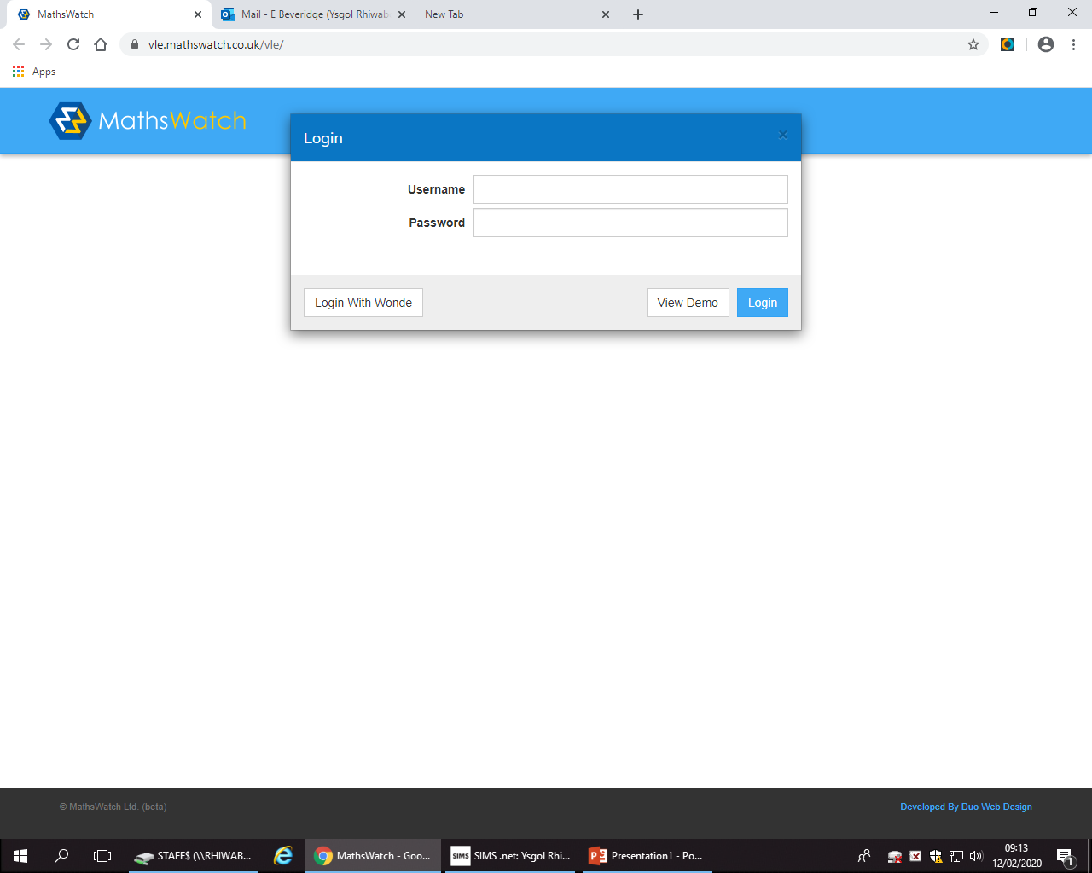

Slide 30
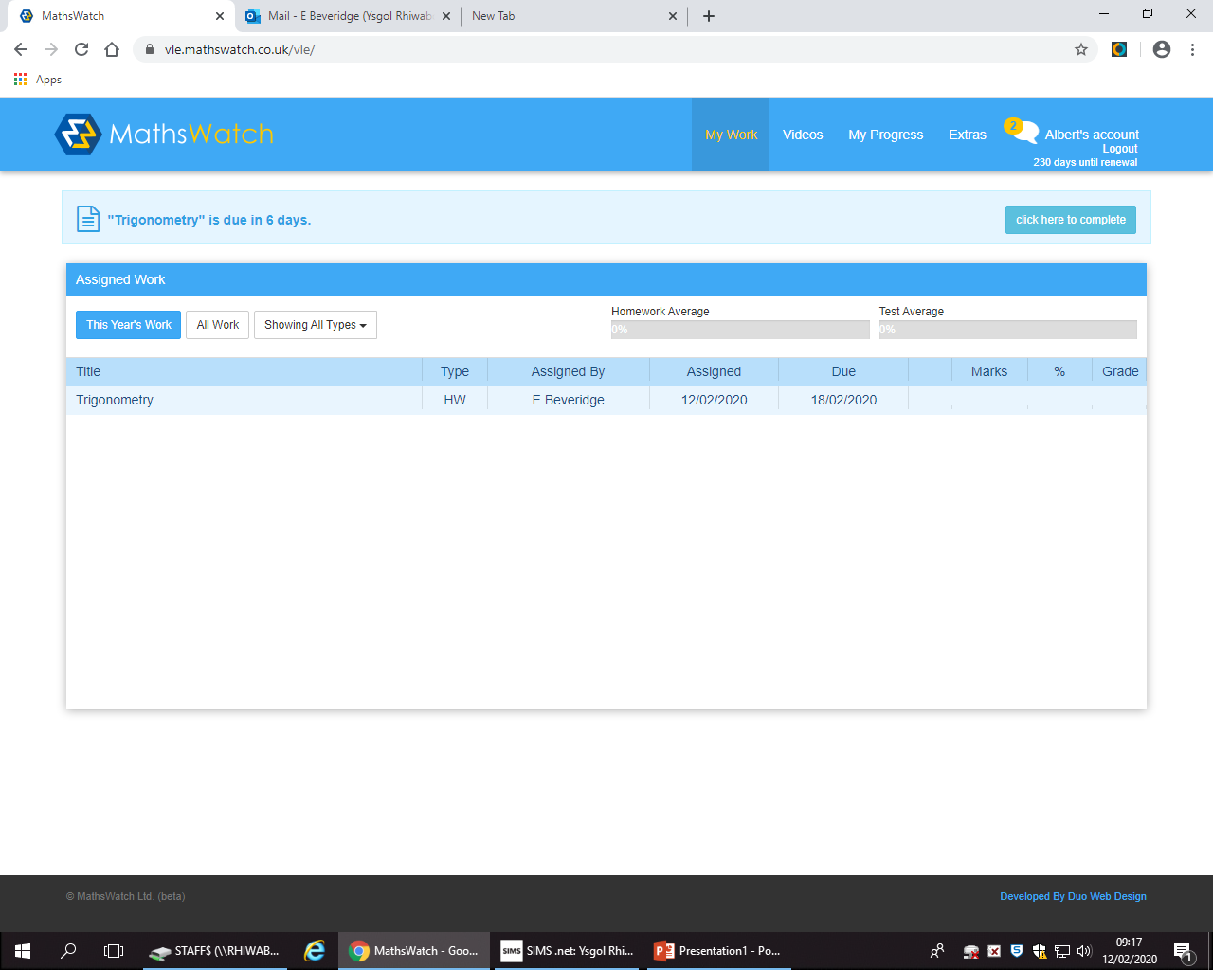

Slide 31
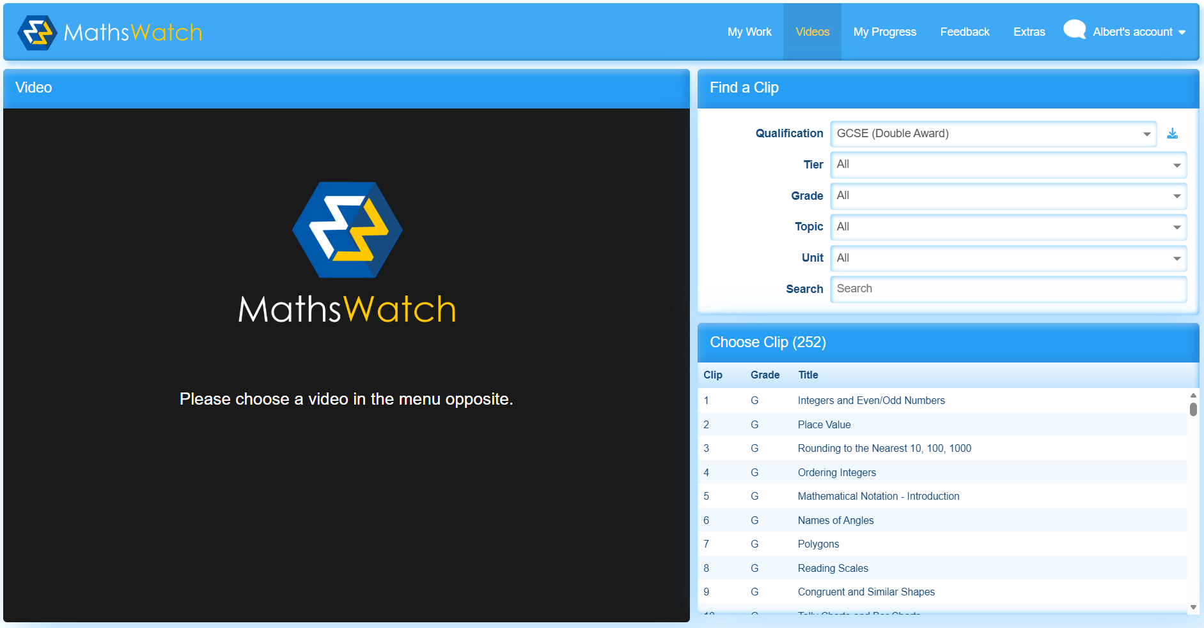

Slide 32
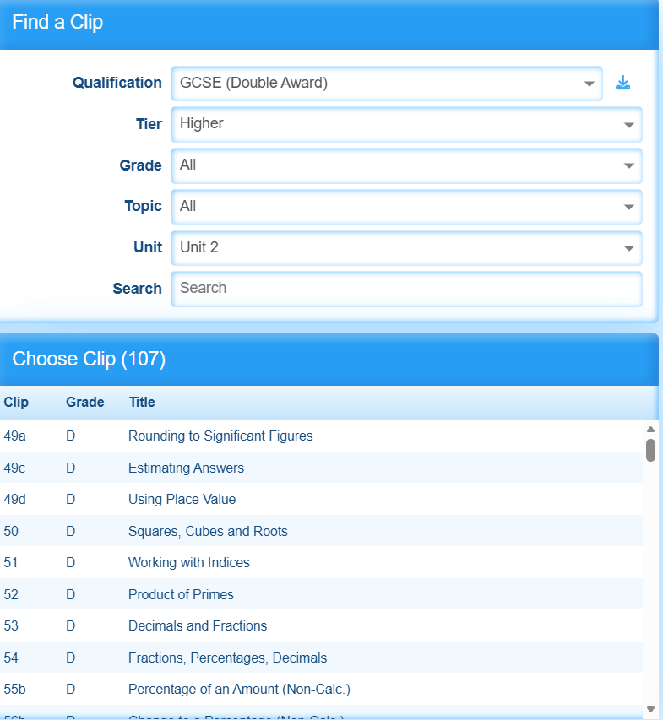

Slide 33
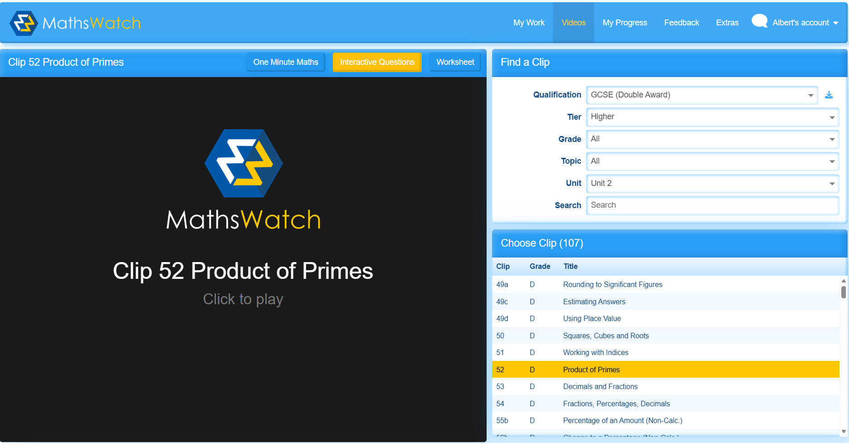

Slide 34
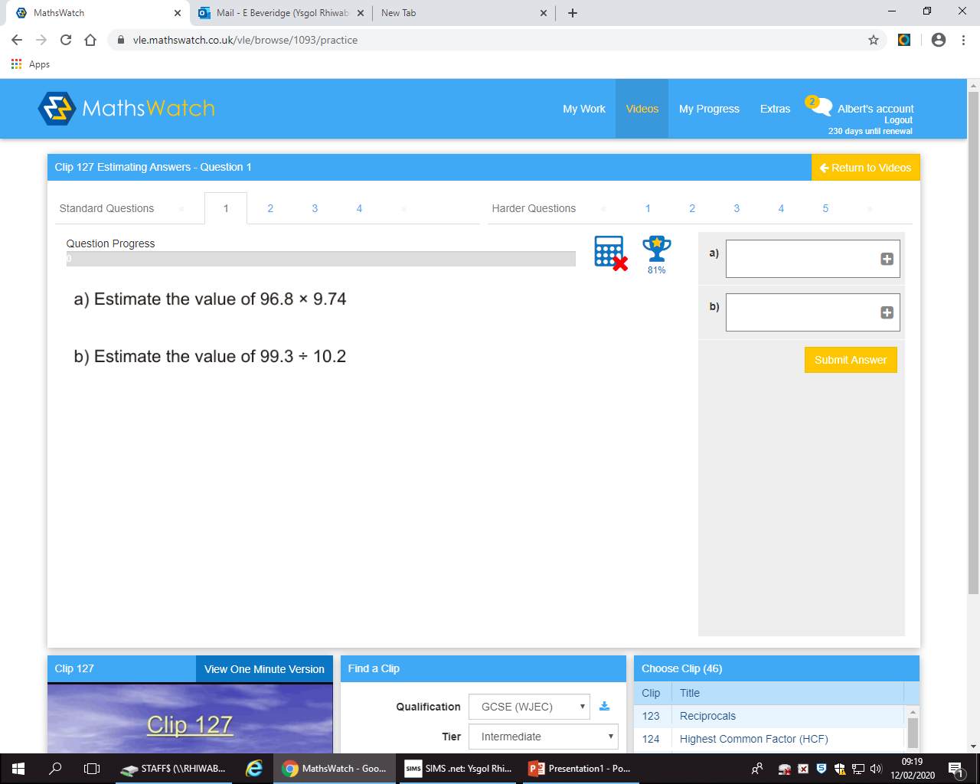

Slide 35
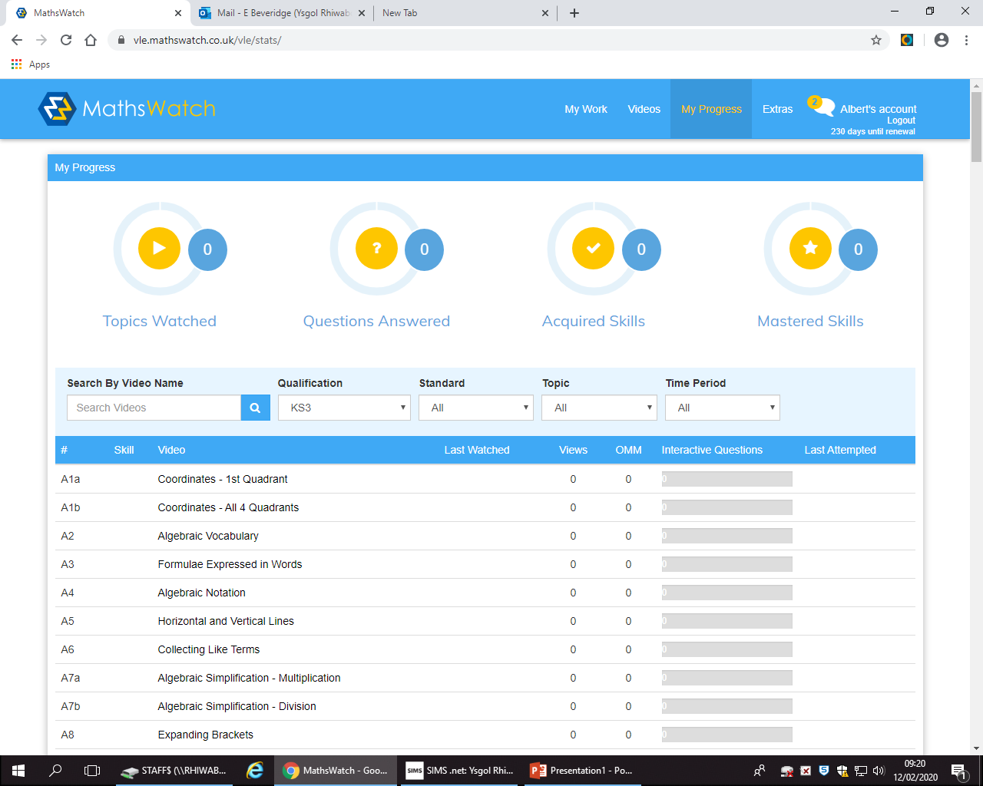

Slide 36
Past Paper Questions
Although we don’t have past papers for this new GCSE, there are still questions we can use to practice.
www.MathsDIY.com

Slide 37
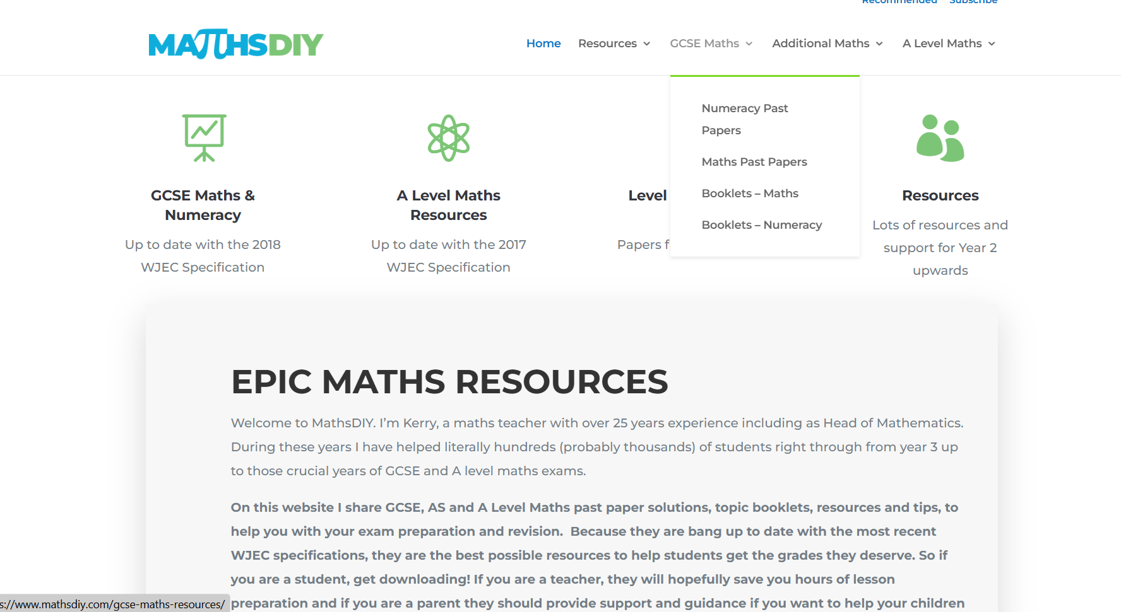

Slide 38


Slide 39
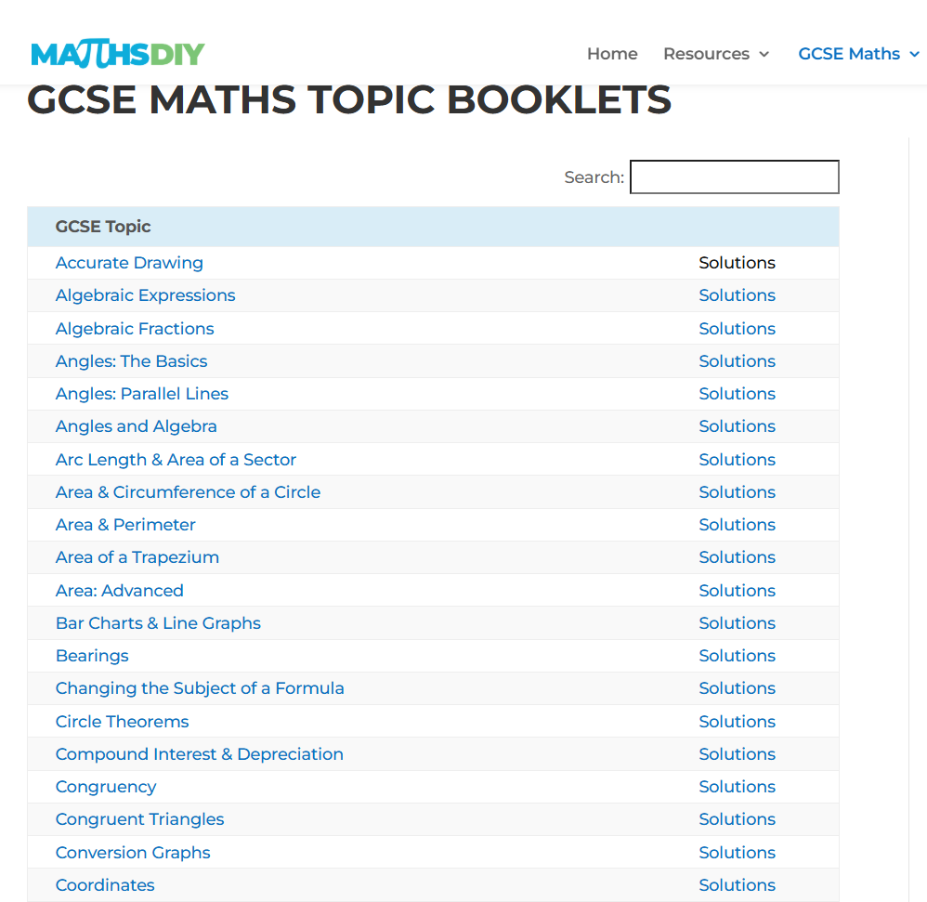
Solutions to check working AFTER you have completed it yourself.

Slide 40
Mock Exam
Wednesday 15th April 2026
Revision Lists have been given on Google Classroom, Text messages sent to all parents.
Paper copies of the revision lists are available to collect tonight.

Slide 41
Revision Sessions
Every Thursday after School
We will also run a long session in
the May half term holidays.
This is the week before their exams.
Revision Checklists have been produced and put on Google Classroom. Paper copies of the checklists are available to collect tonight.

Slide 42
Science
Mr M Robinson

Slide 43
Science Double Award
Two GCSE grades at the end of Year 11.
Best of the two grades counts.
Nearly half the marks come from Year 10 GCSE exams.

Slide 44
Year 10 Exams
All of the exams are in June 2026.
1 Biology exam Monday 8th June
1 Chemistry exam Friday 12th June Worth 45% final grade
1 Physics exam Monday 15th June

Slide 45
Support for Students
Tanio.cymru on Google Classroom.
Knowledge organisers to support revision.
Regular tests, assessments and feedback.
Revision sessions after school from March 10th.

Slide 46


Slide 47
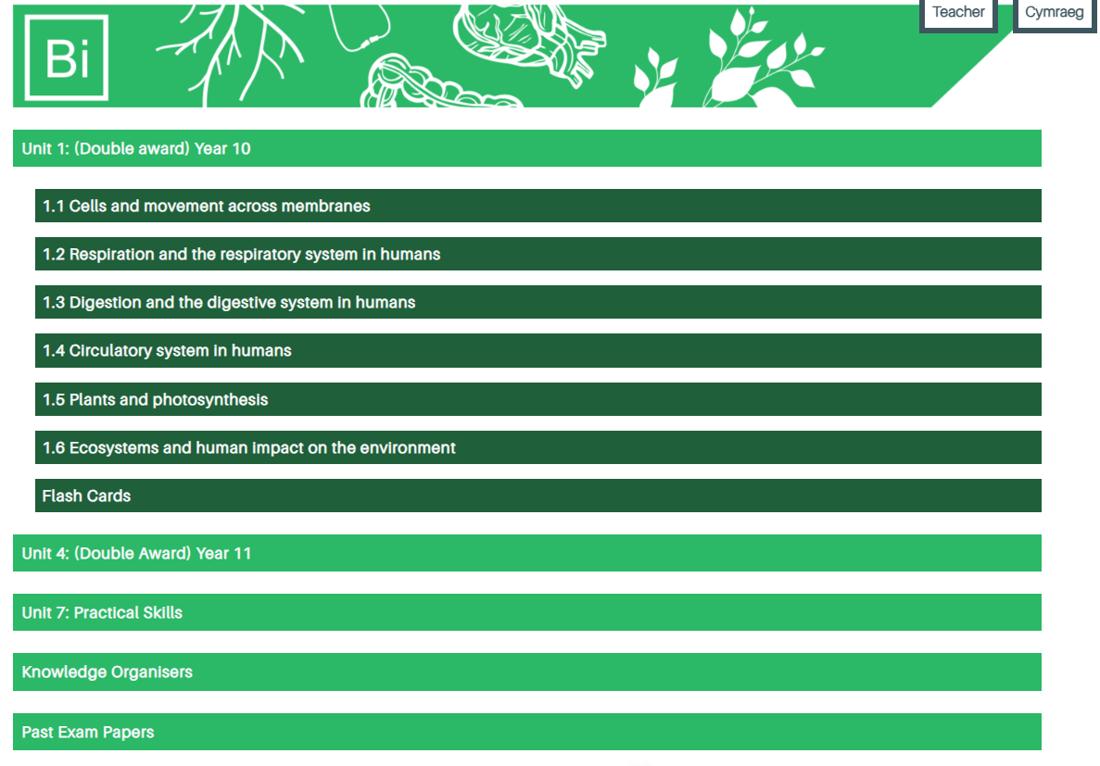

Slide 48
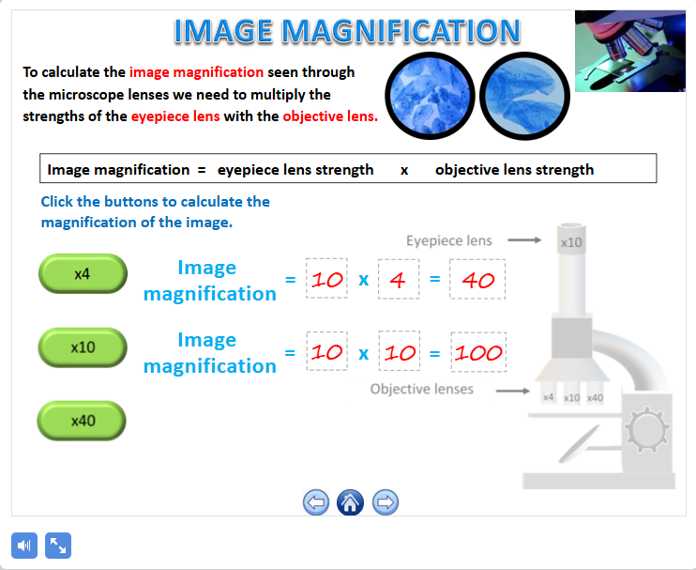

Slide 49
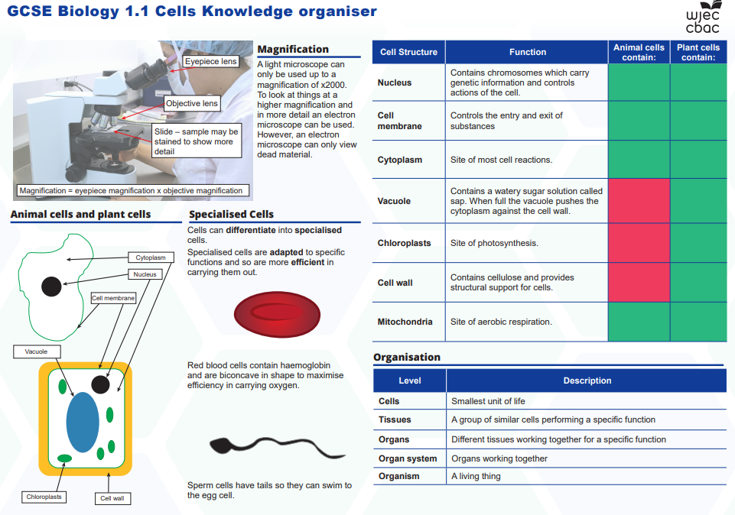

Slide 50
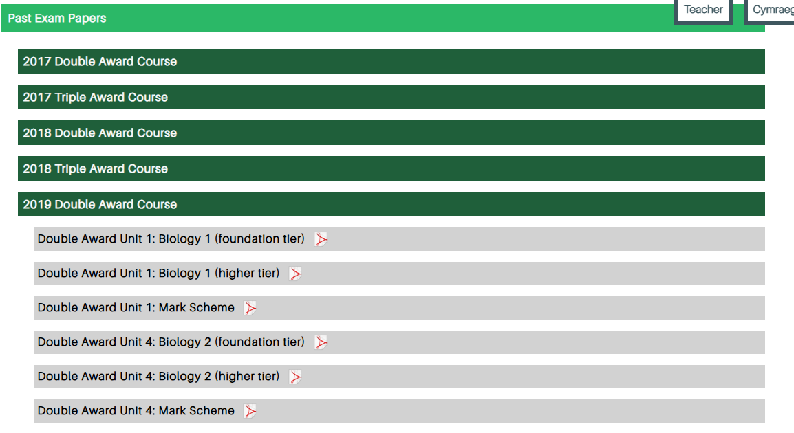

Slide 51
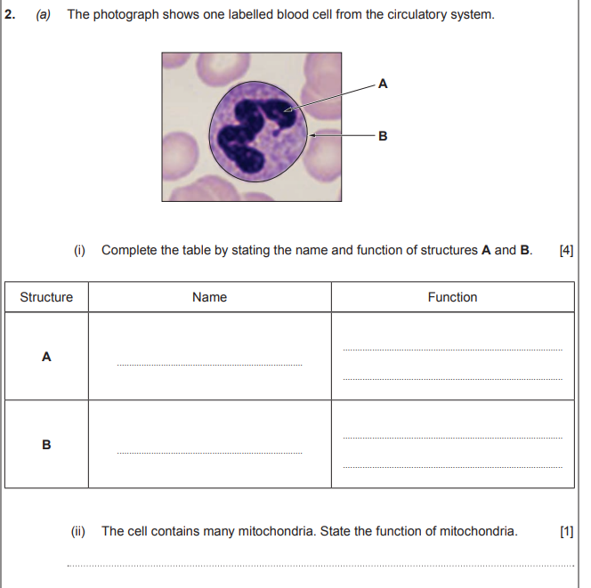
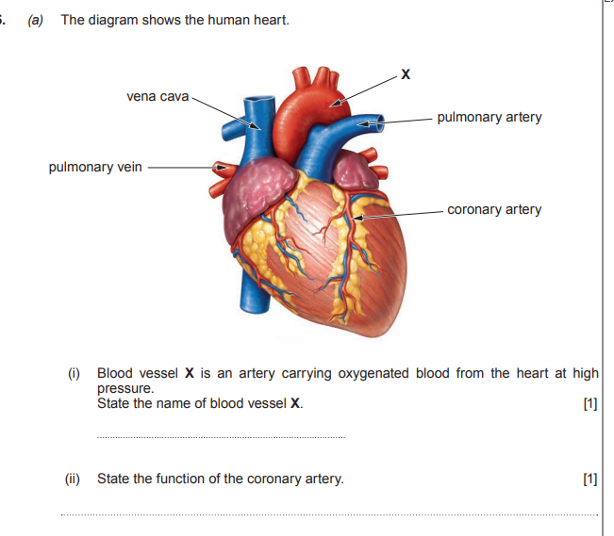

Slide 52
Second Mock Exam before Half Term
There will be a formal mock exam in Biology, Chemistry and Physics in the last week before Easter.
All students have knowledge organisers and example questions.

