Slide 1
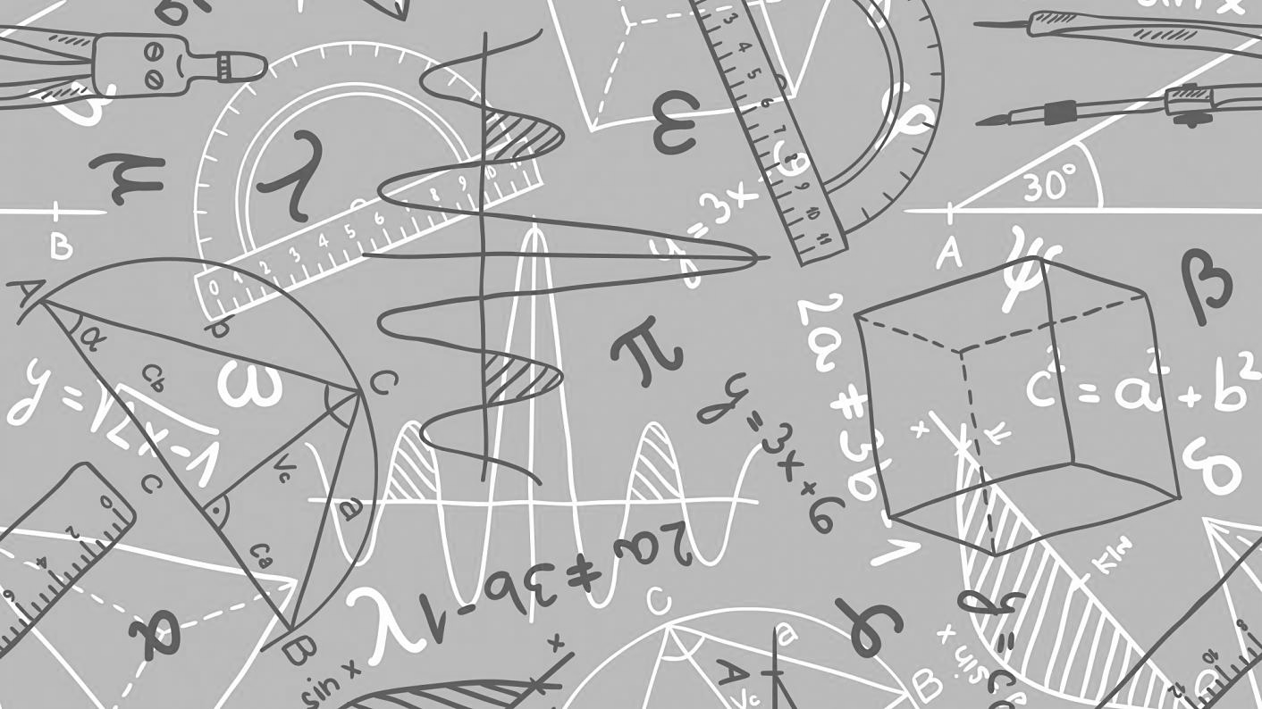
Maths
We can’t wait to meet you…
All the Maths teachers at Ysgol Rhiwabon are very much looking forward to meeting you. Normally during transition weeks you find out about us, we find out about you and together we do some Maths. Unfortunately due to transition being slightly different this year, it is likely we may not meet in person before September. Hopefully completing this booklet you will be able to find out some facts about the Maths teachers at Ysgol Rhiwabon, do some research into some of our favourite Mathematicians and do some Maths either on your own or with your family/carers.

Slide 2
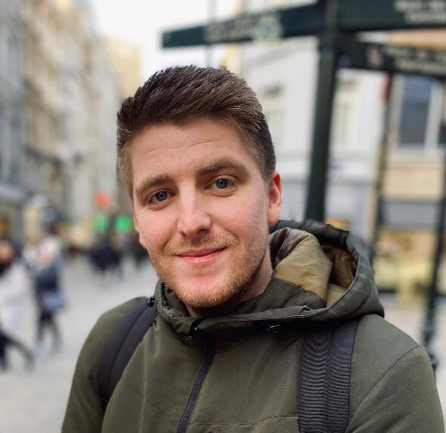
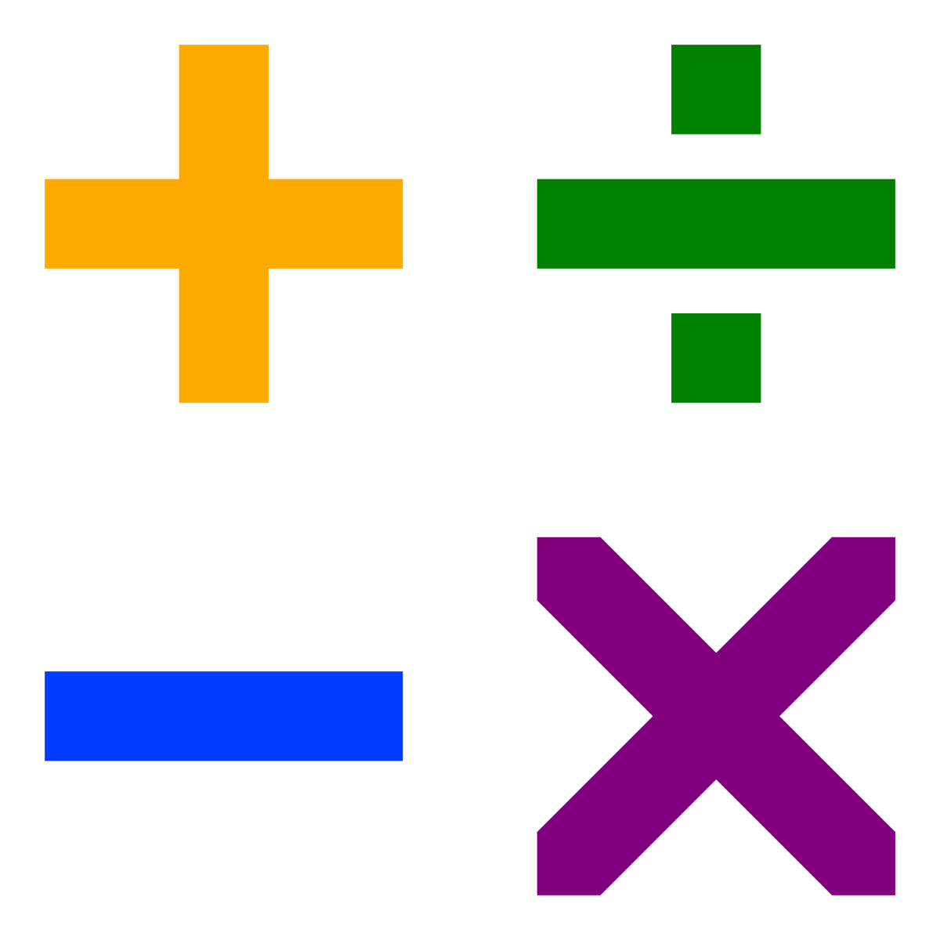
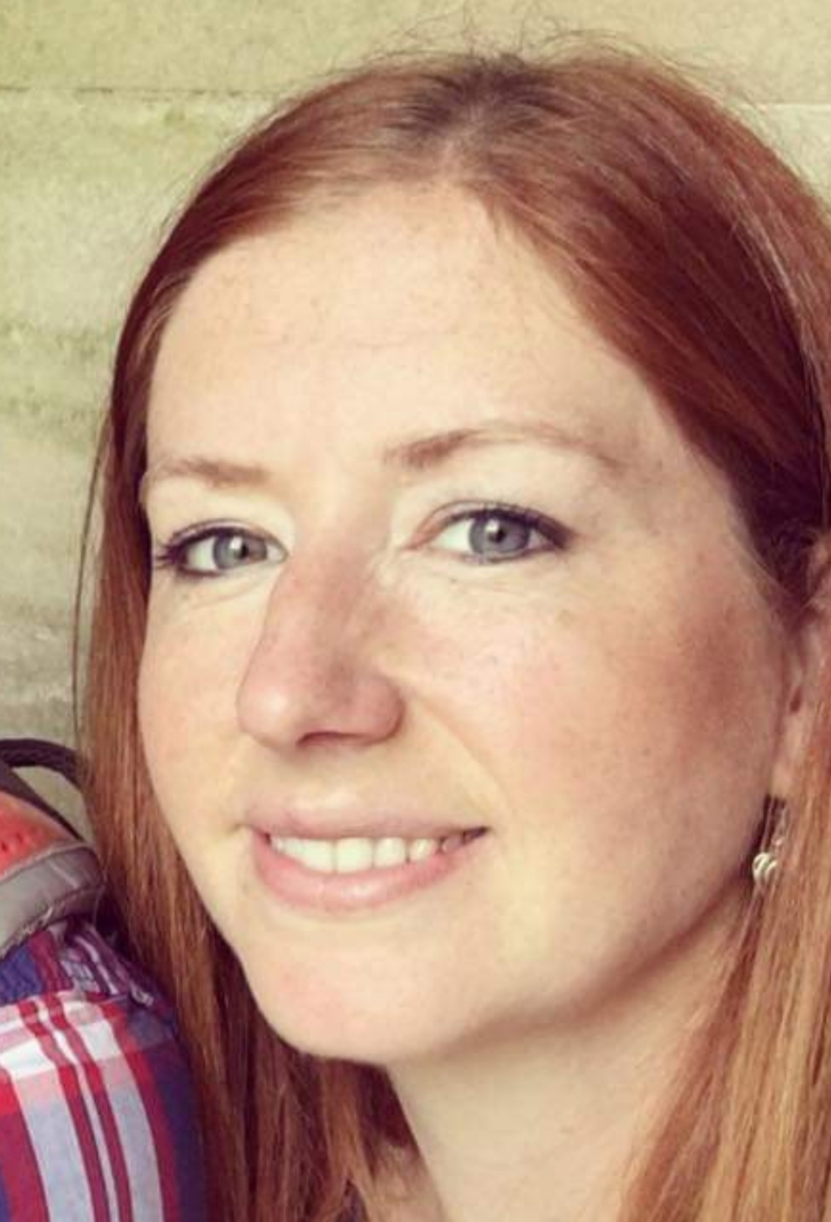
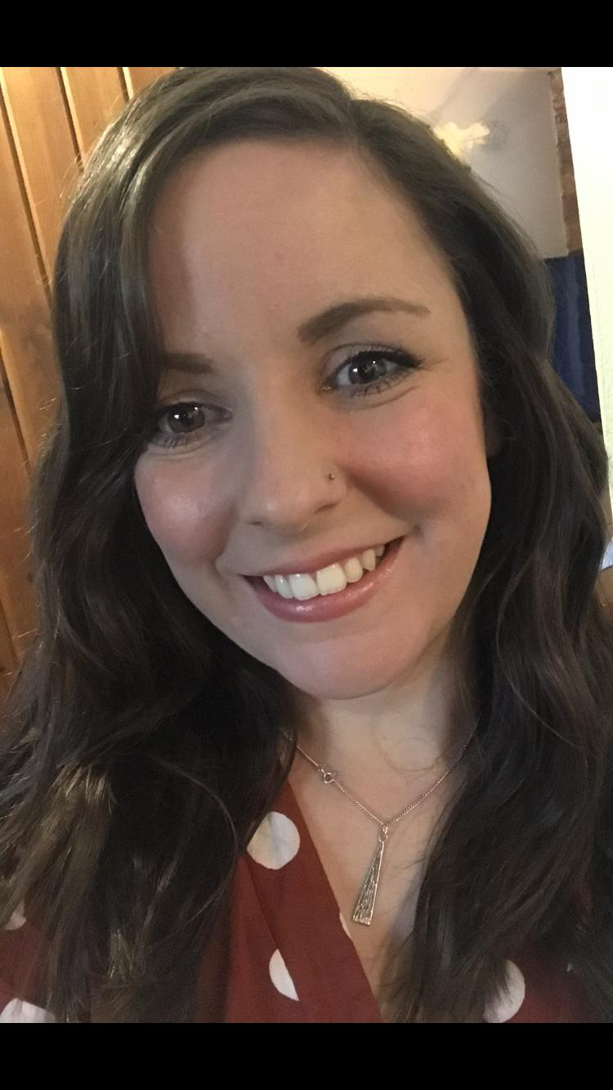
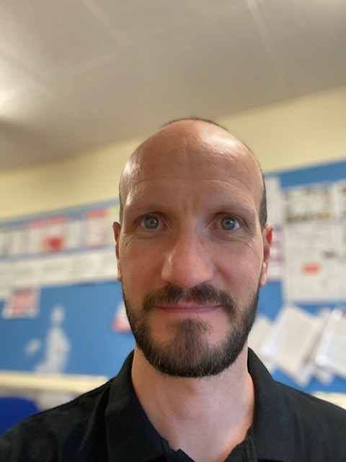
Meet the department…
Mrs Williams
Mr Tonks
Mrs Beveridge
Mrs Lewis
Mr Bingham

Slide 3
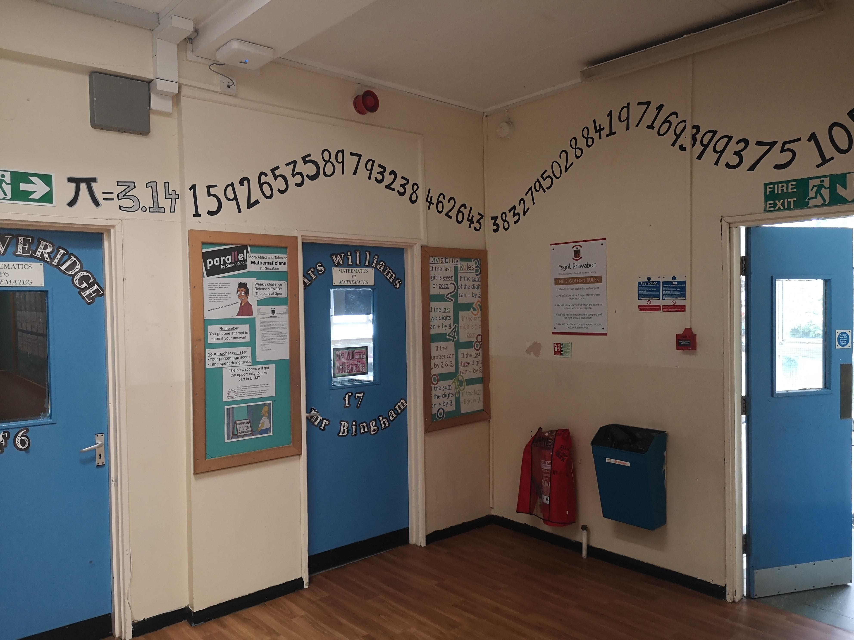
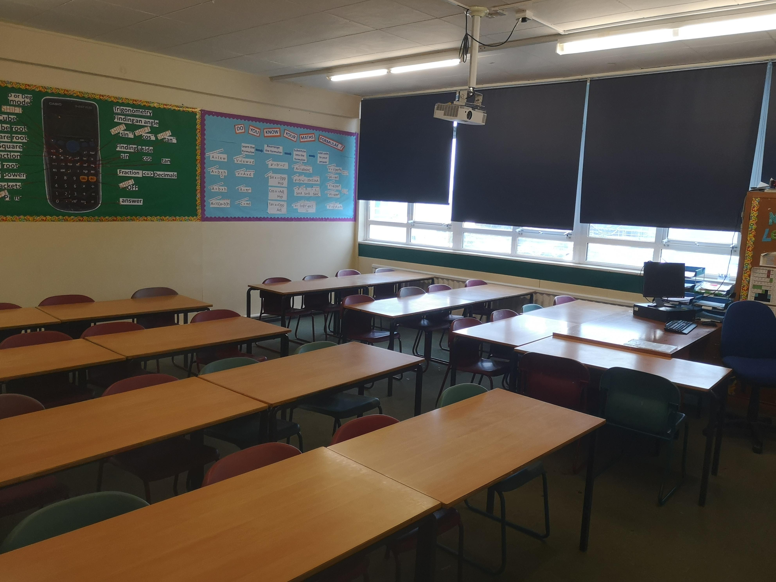
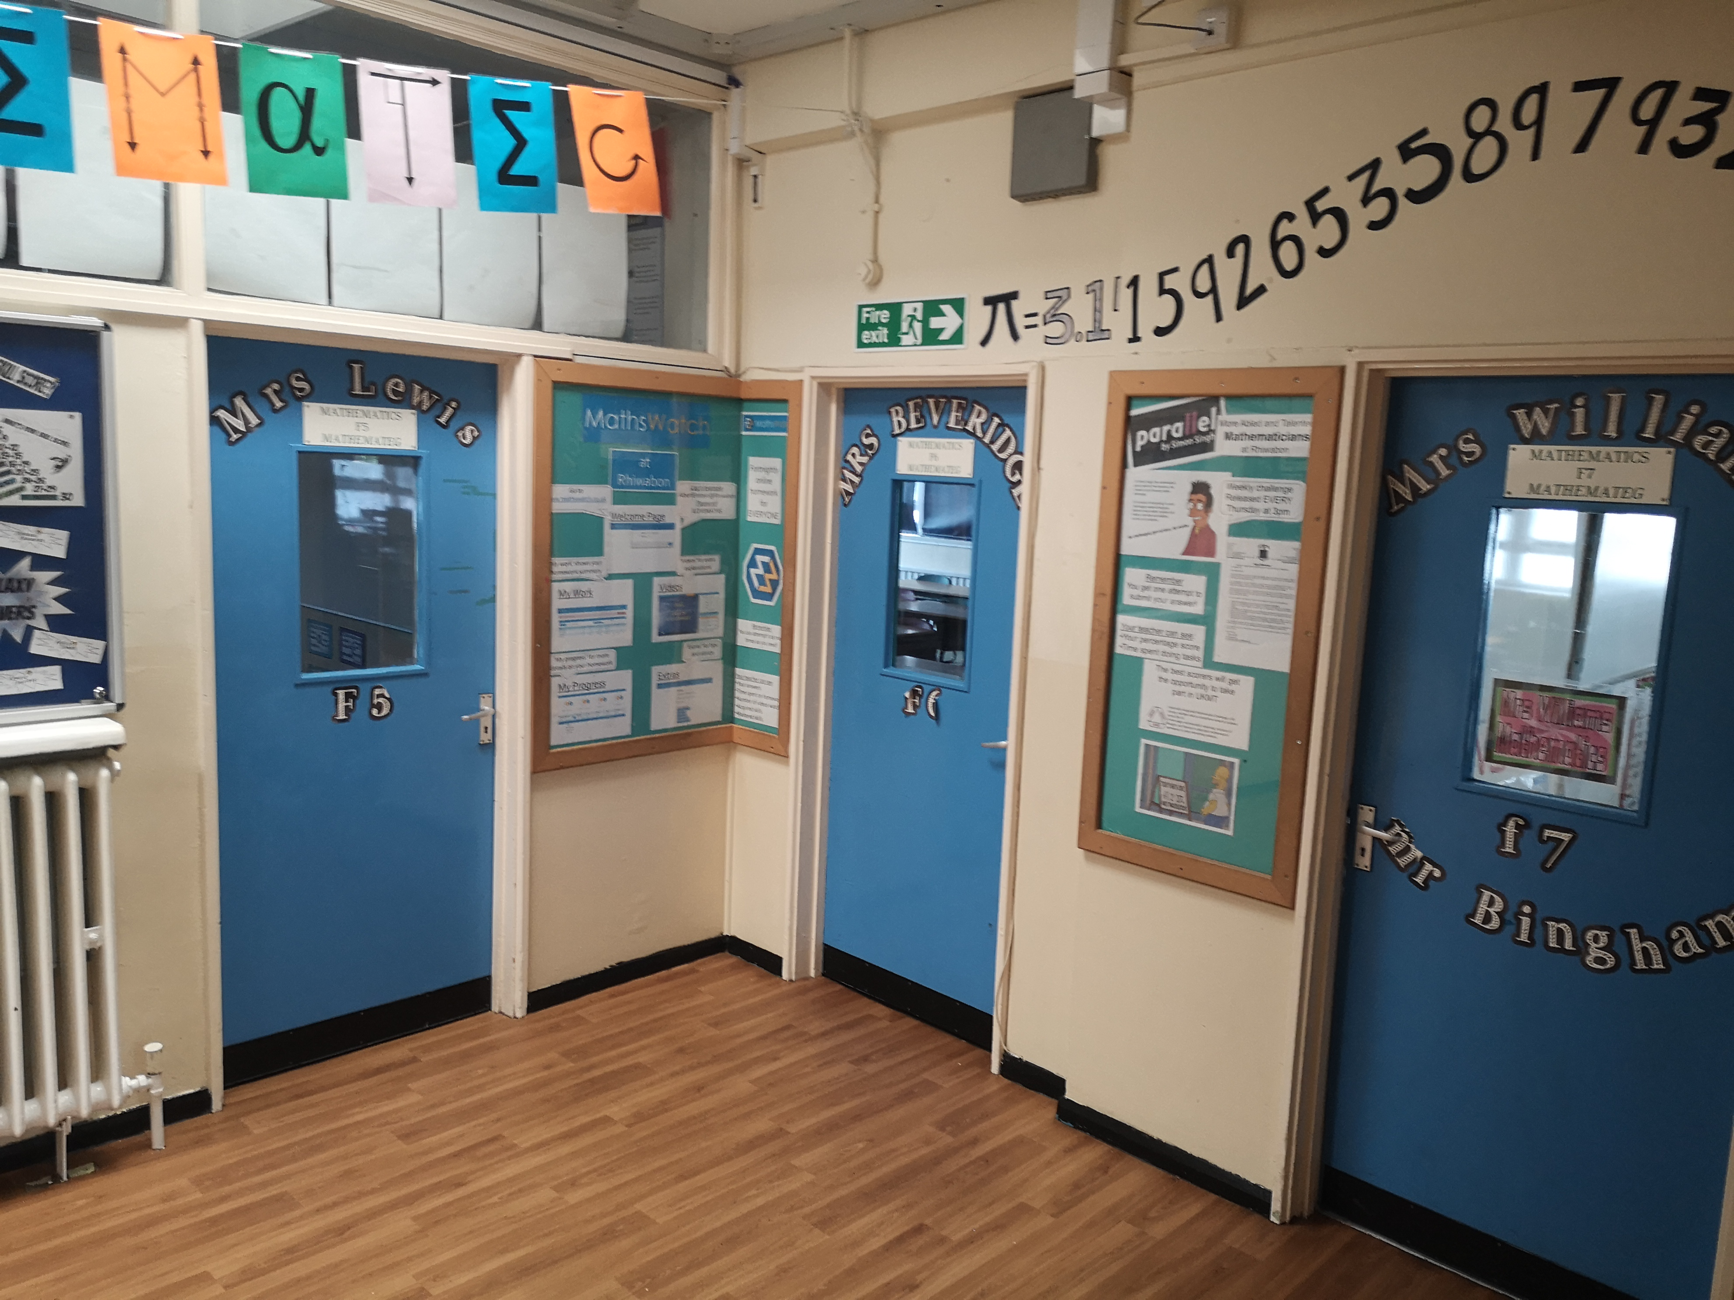
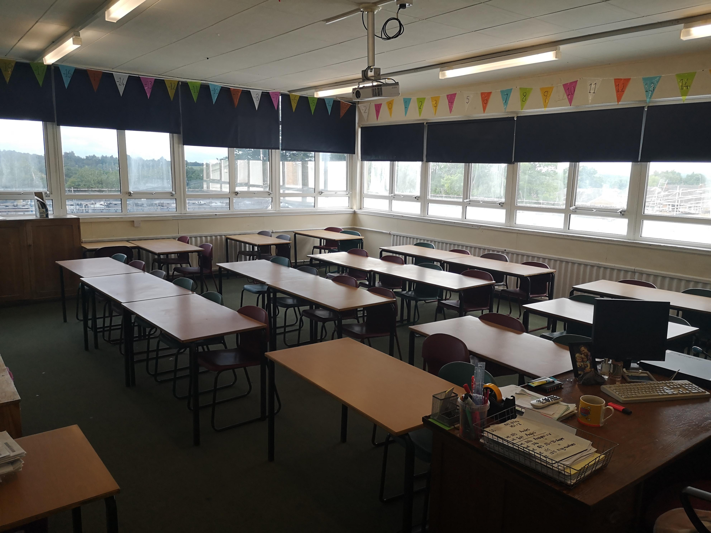
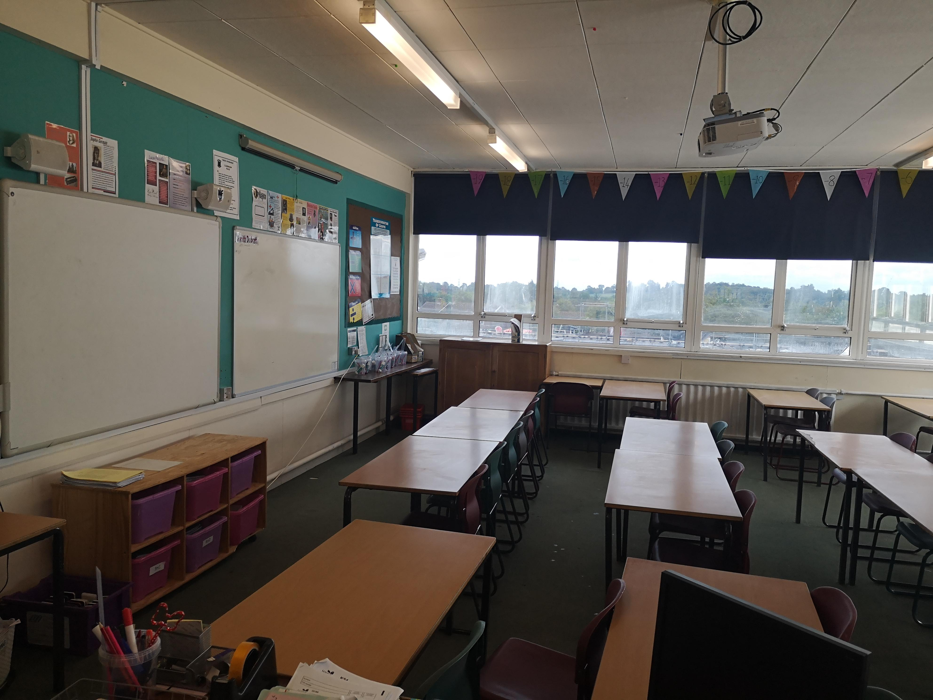
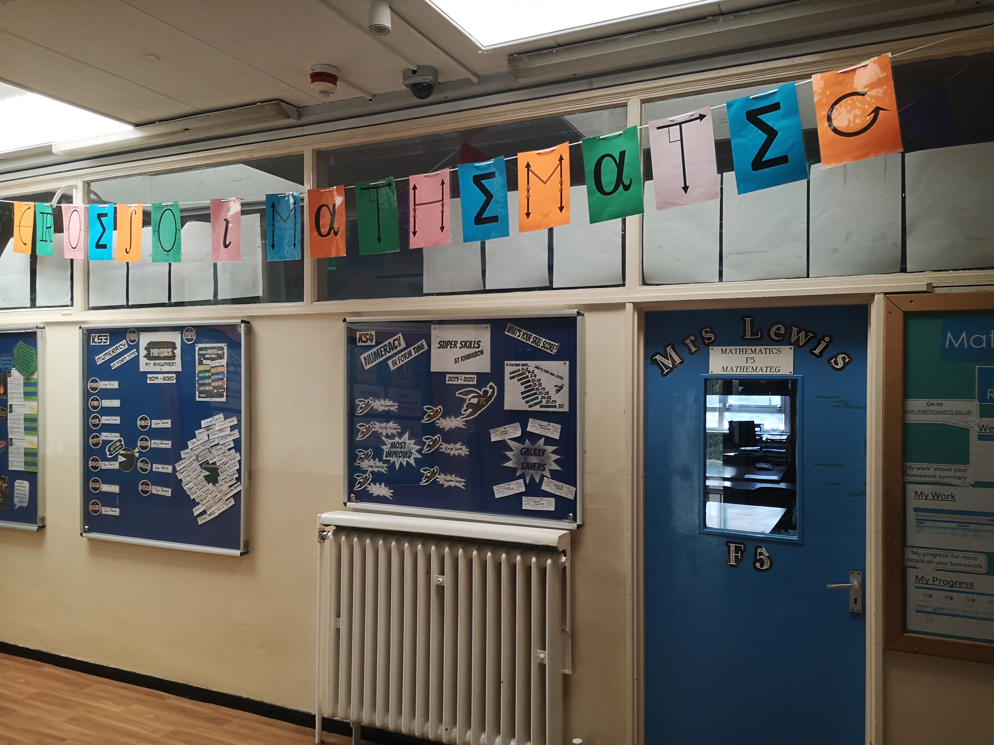
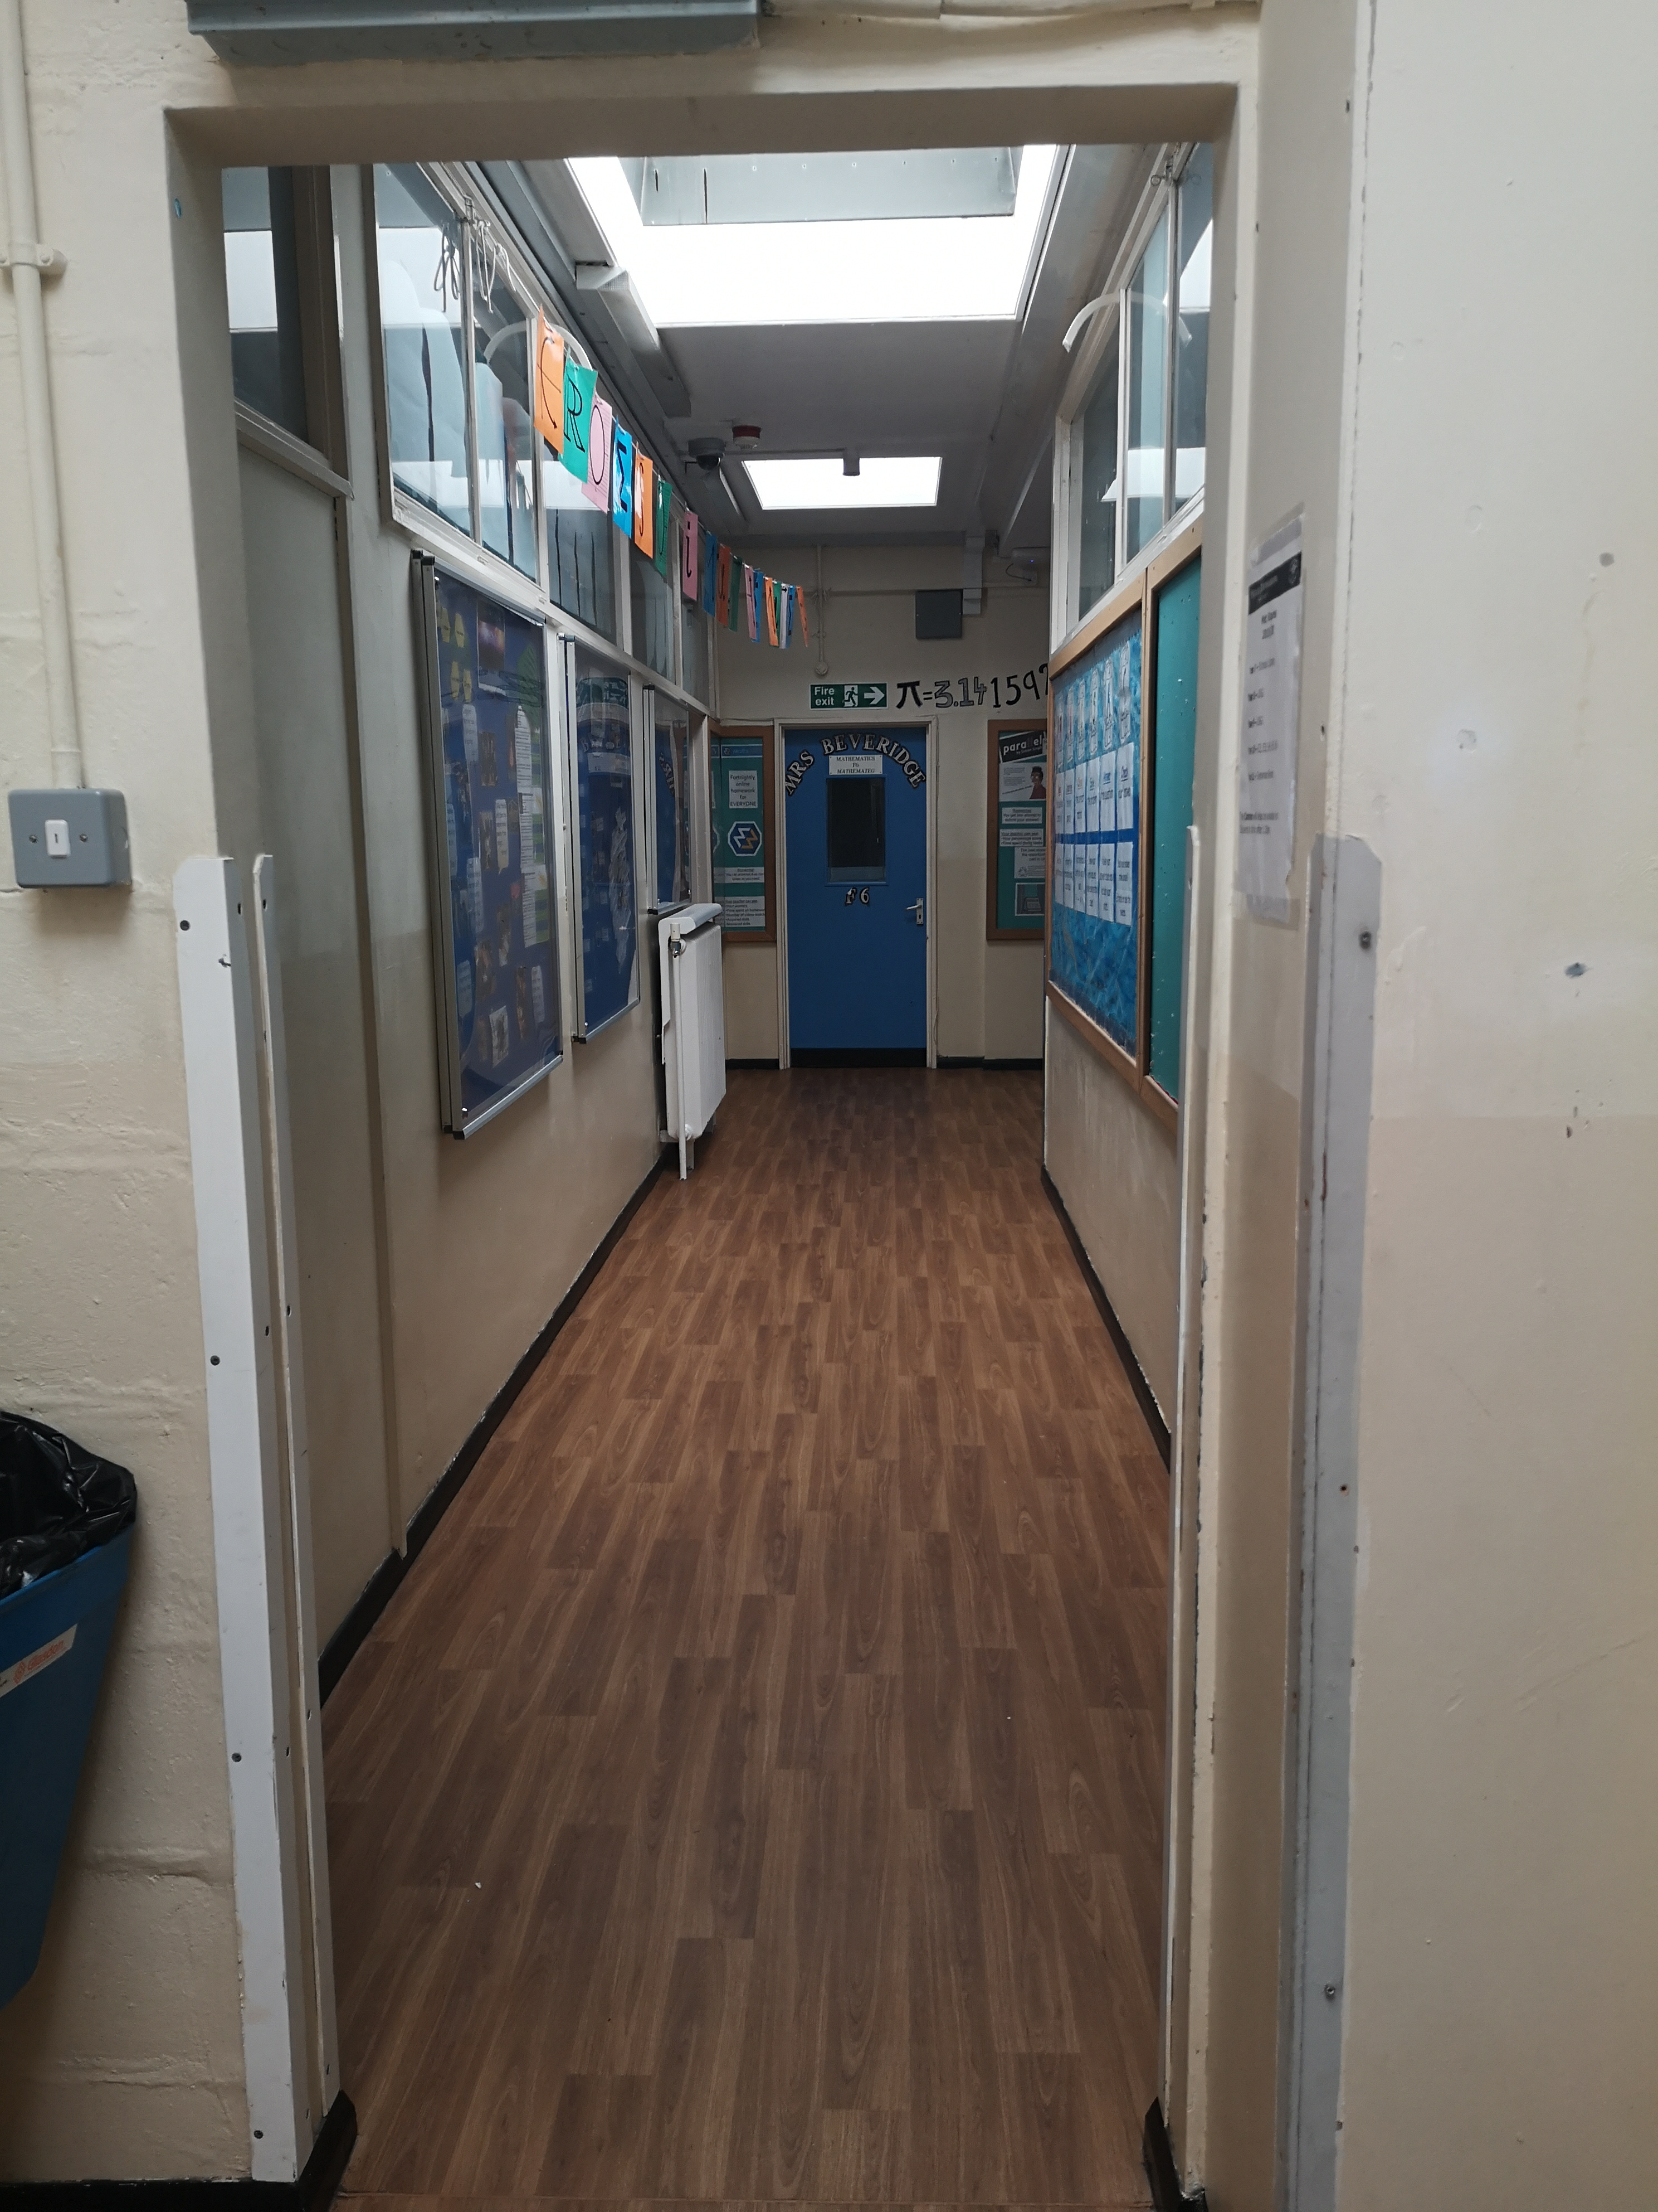
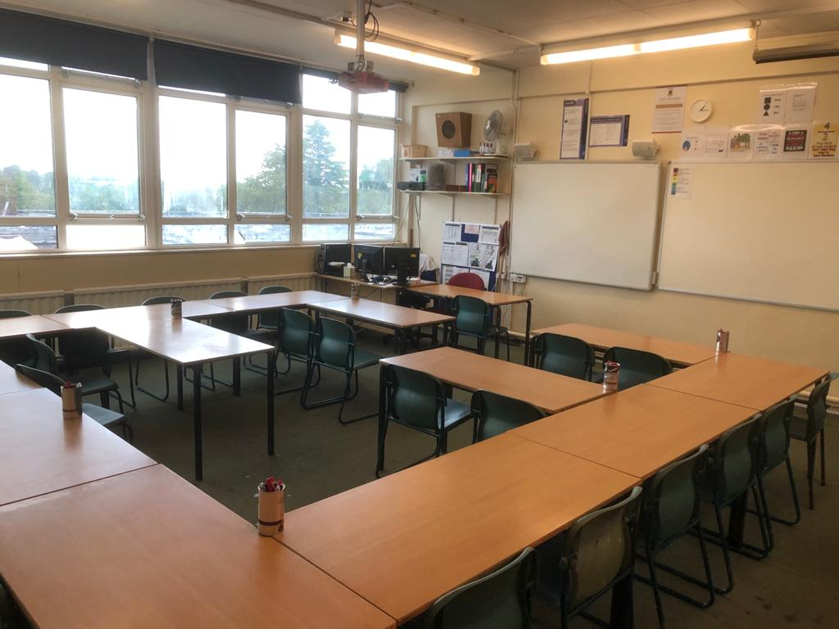
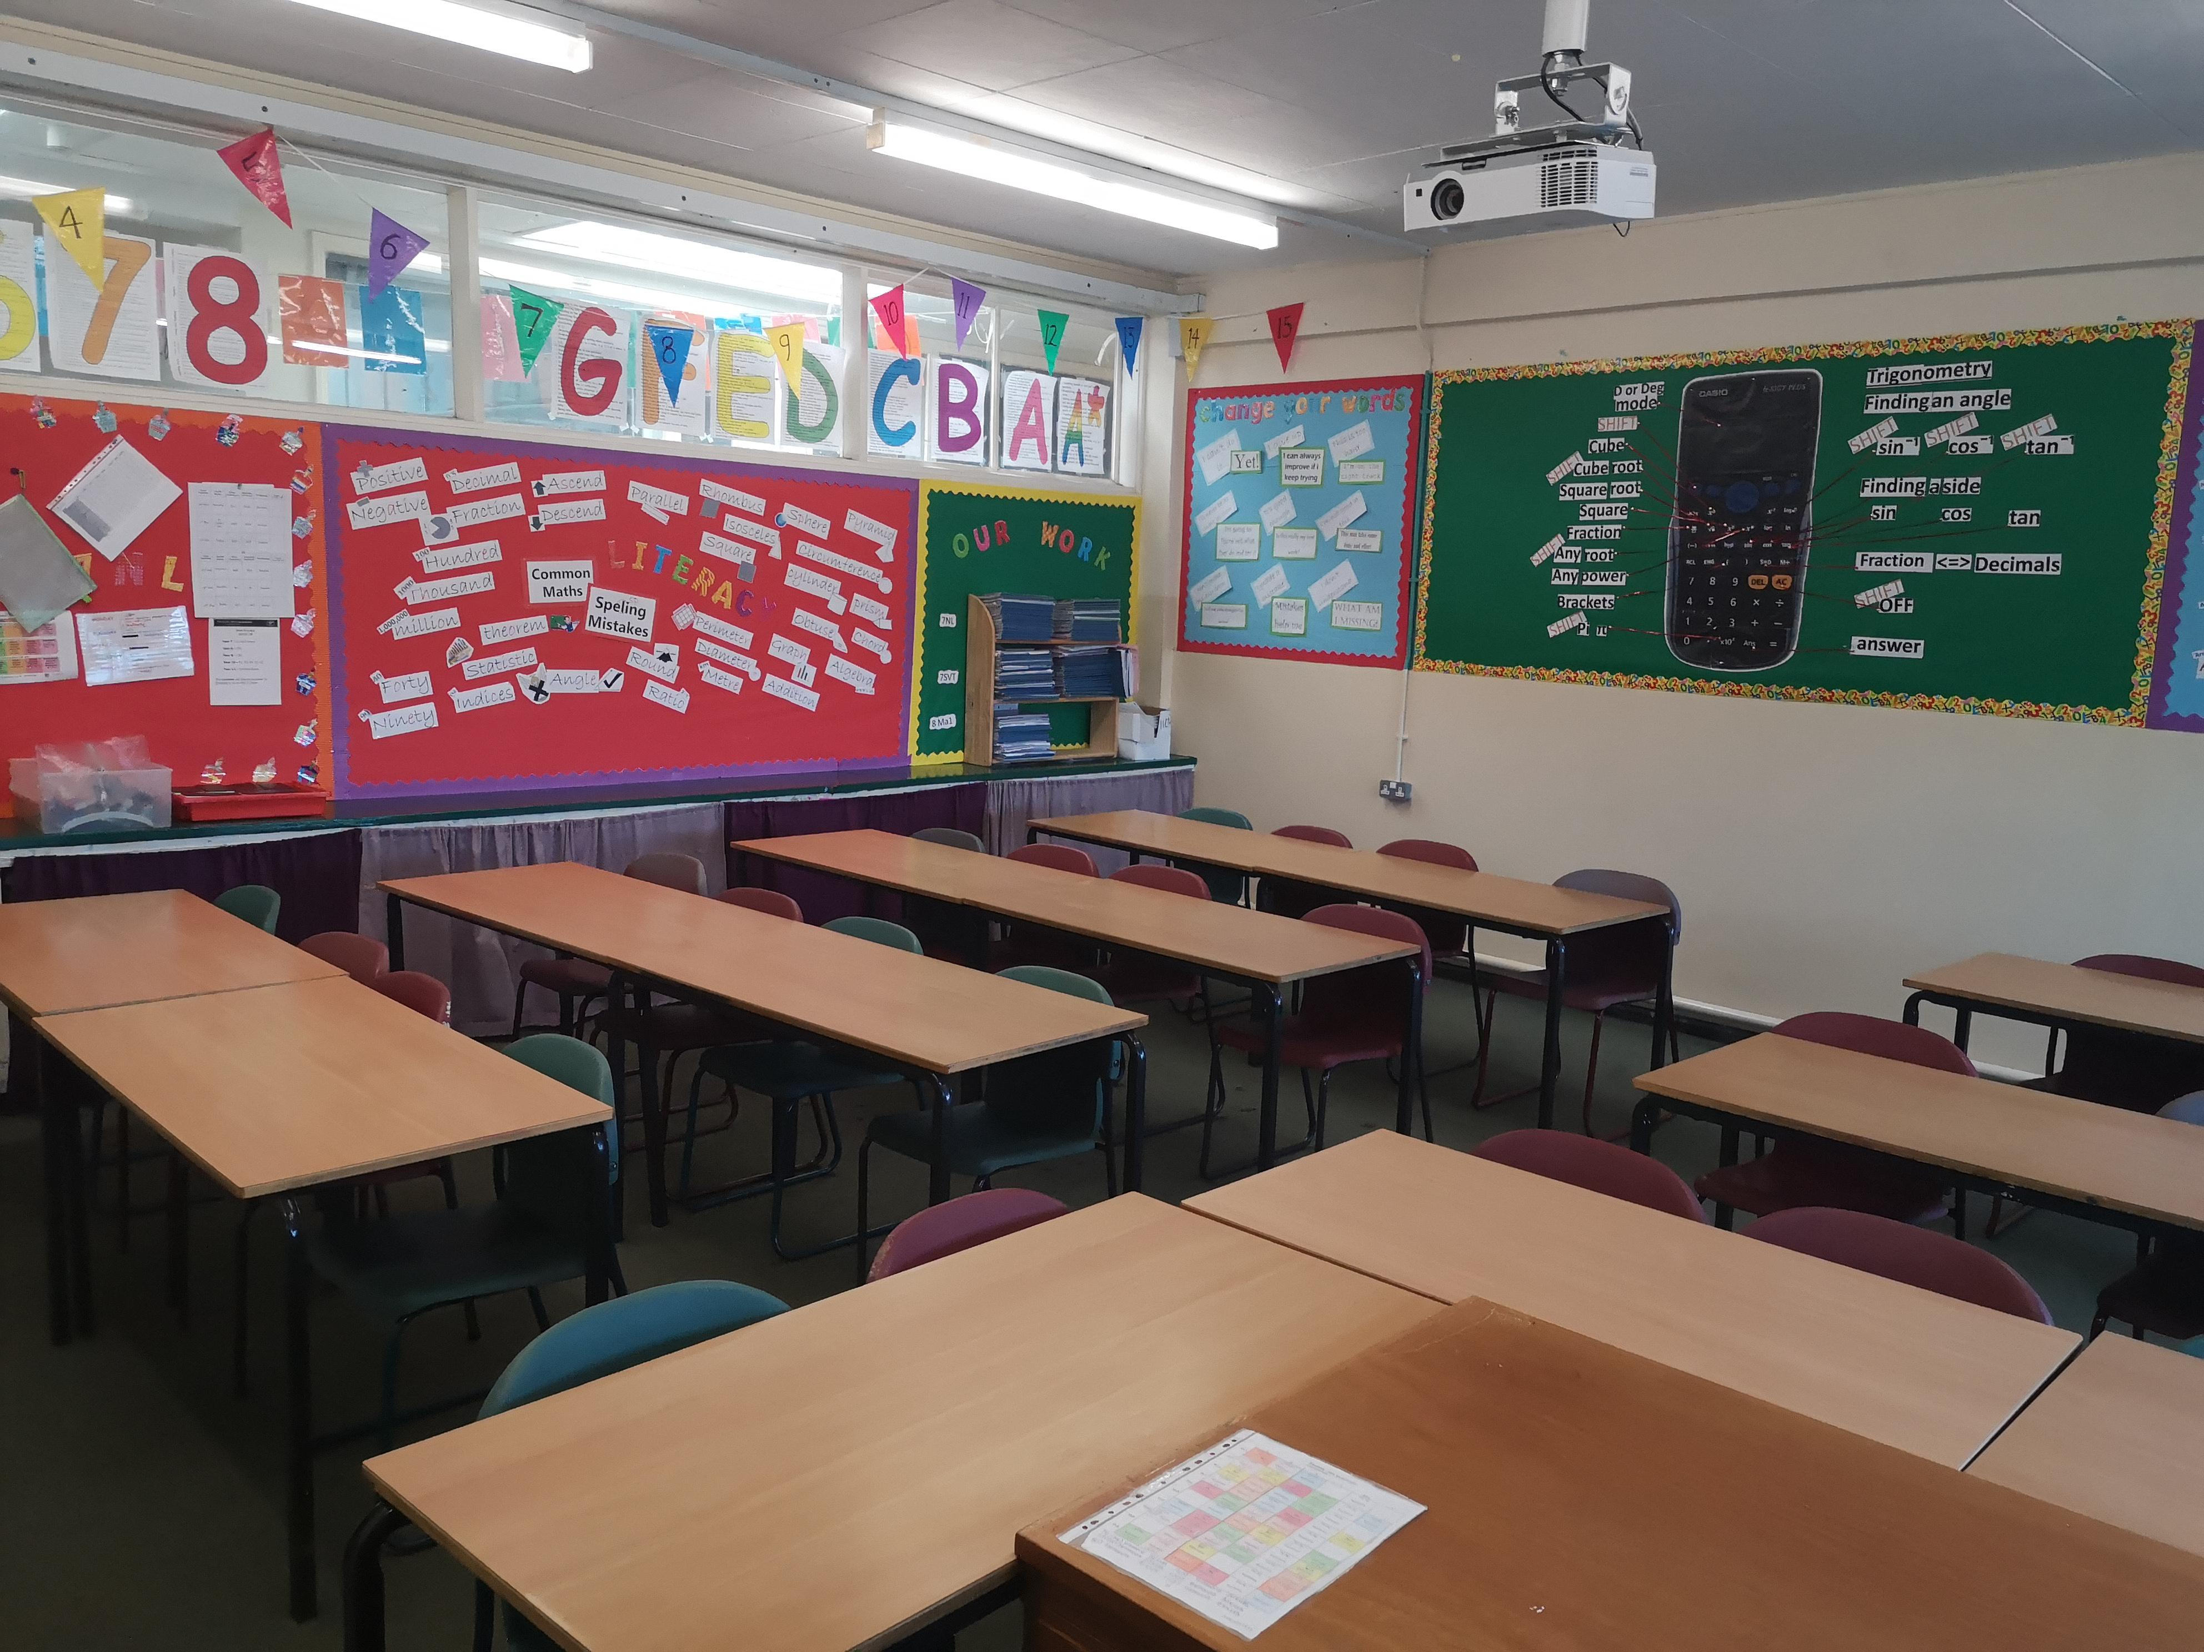

Slide 4
The 24 game…
One of our favourite things to do on transition is to play the 24 game. The aim of the game is to be the first person to make the number 24.
For each game you have 4 numbers, you have to use ALL four numbers, you can add, subtract, multiply or divide these to make 24.
Example:
2 2 6 8
To make 24, I can do (8 - 2) x (6 – 2)
8 -2 = 6
6 -2 = 4
6 x 4 = 24
Now it’s your turn, the 24 cards are below they get harder as you go through.
Try this with your family – who is the quickest?
One Dot - Easiest
Mrs Williams’ favourite number is the sum of 4 + 7

Slide 5
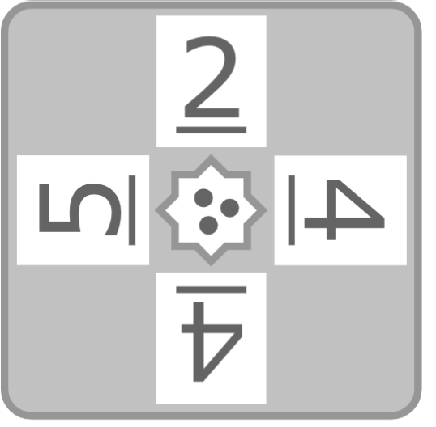
The 24 game…
Mr Tonks favourite number is 70 divided by 5
two Dot - medium
three Dot - harder

Slide 6
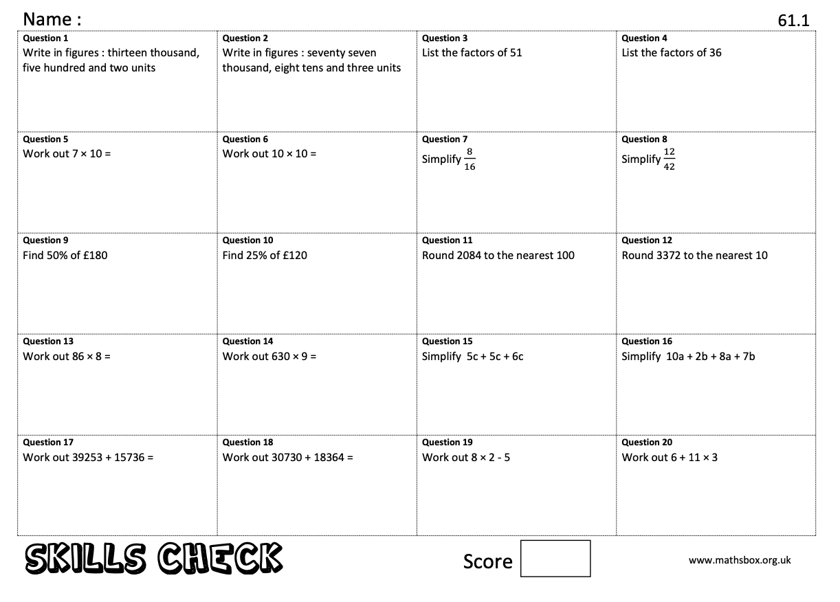
Mrs Beveridge’s favourite number is
3² - $√4$
Key Skills…
When you get to a page like this, spend 10 minutes completing
the skills check questions based on topics from Y6.
Mrs Lewis’ favourite Mathematician is Fibonacci who was an Italian man who studied Maths and theories back in the 11th century. He discovered a pattern called the Fibonacci sequence. It's a series of numbers that starts with 0 and 1, and each number after is found by adding the two previous numbers (0, 1, 1, 2, 3, 5…)The sequence just keeps going on and on.
Can you find the first 10 numbers in the sequence?

Slide 7
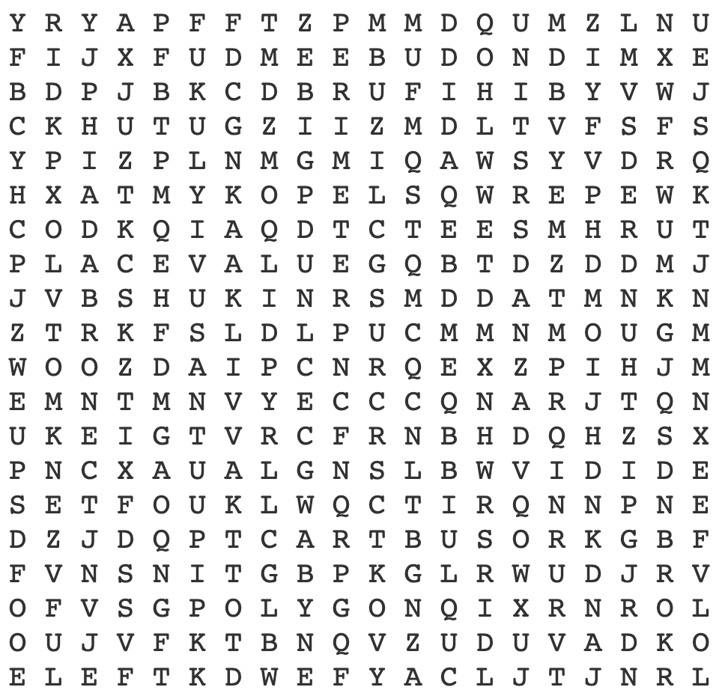
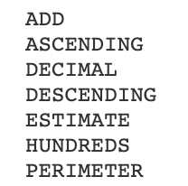
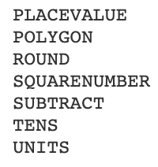
Maths Keywords…
Sometimes in Maths lesson you will be asked to write the Maths keywords down in your book. Can you find all the keywords you will need for your first half term at Ysgol Rhiwabon?
Mrs Lewis’ favourite number is 5 squared
Mrs Williams’ favourite Mathematician, Leonhard Euler (pronounced Oiler), was an 18th century Swiss Mathematician and Physicist. He spent most of his life in Russia and Germany. Euler made important discoveries in fields like calculus and topology. He also made many of the words used in Maths today.

Slide 8
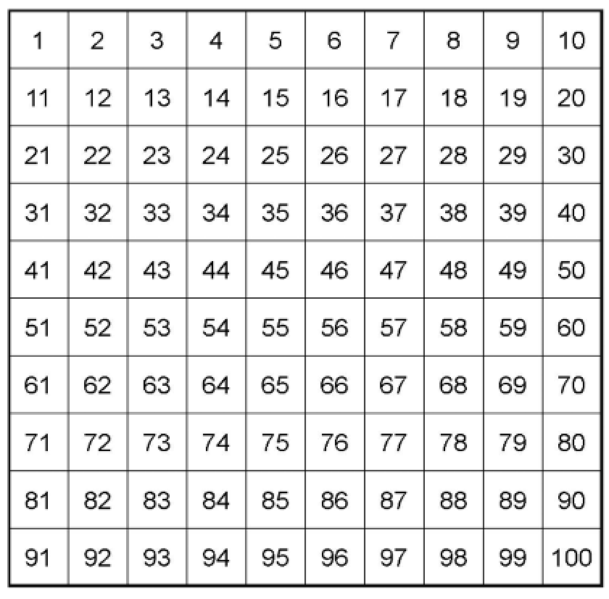
Mr. Bingham’s Favourite Number
Mr. Bingham is one of our Assistant Headteachers. He has sent me some clues to his favourite number. Can you work out Mr. Bingham’s favourite number?

Slide 9
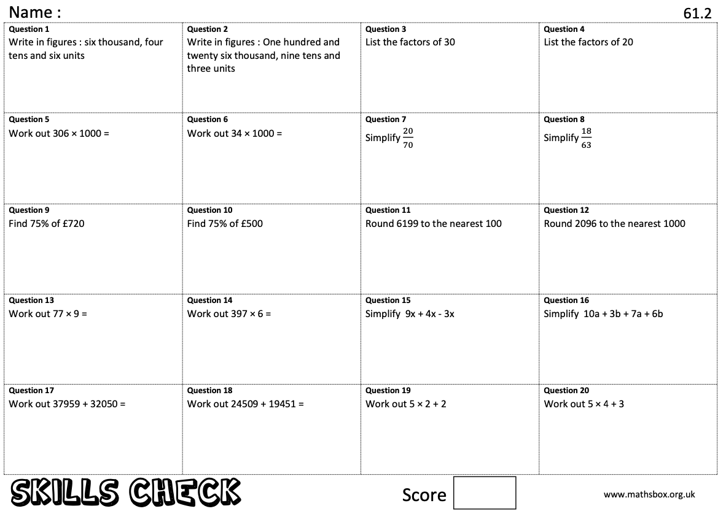
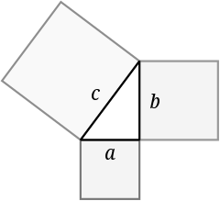
Key Skills…
Mr Cowlinshaw’s favourite number is the product of
3 x 3 x 3
When you get to a page like this, spend 10 minutes completing
the skills check questions based on topics from Y6.
Pythagoras of Samos was a famous Greek Mathematician and Philosopher (c. 570 – c. 495 BC). He is best known for the proof of the important Pythagorean theorem, which is about right angled triangles. He started a group of Mathematicians, called the Pythagoreans, who worshiped numbers and lived like monks.
Can you find out what the Pythagorean theorem is? You will use it in Year 9.
Mrs Beveridge’s favourite Mathematician

Slide 10
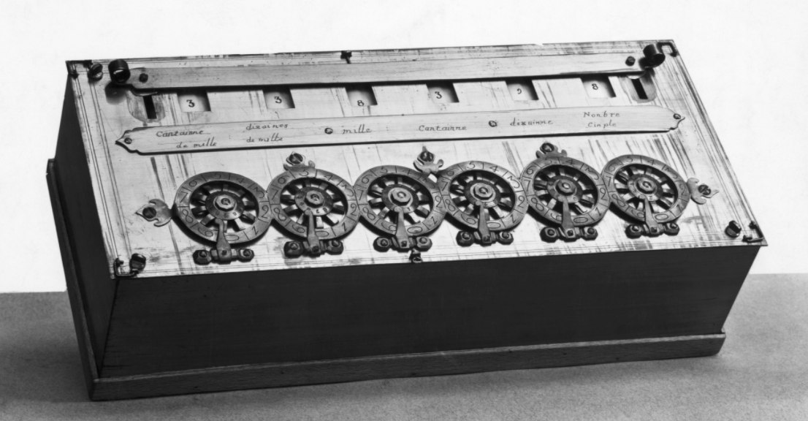
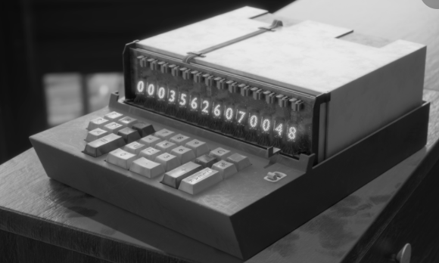
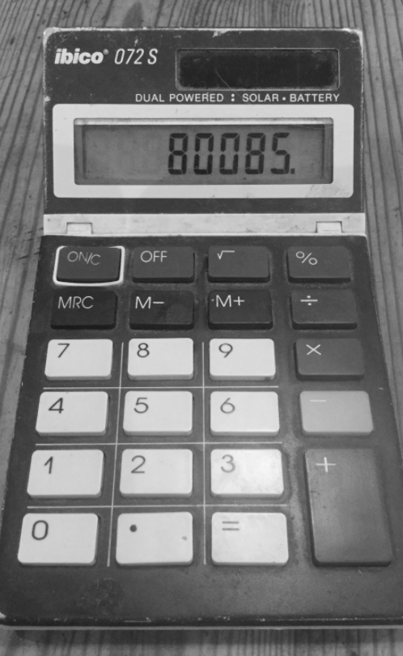
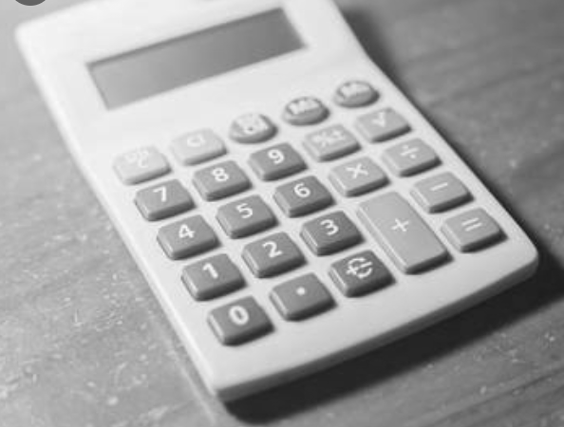
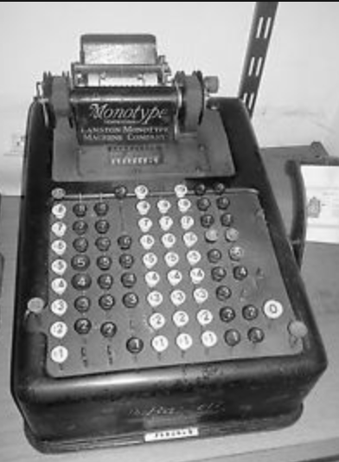
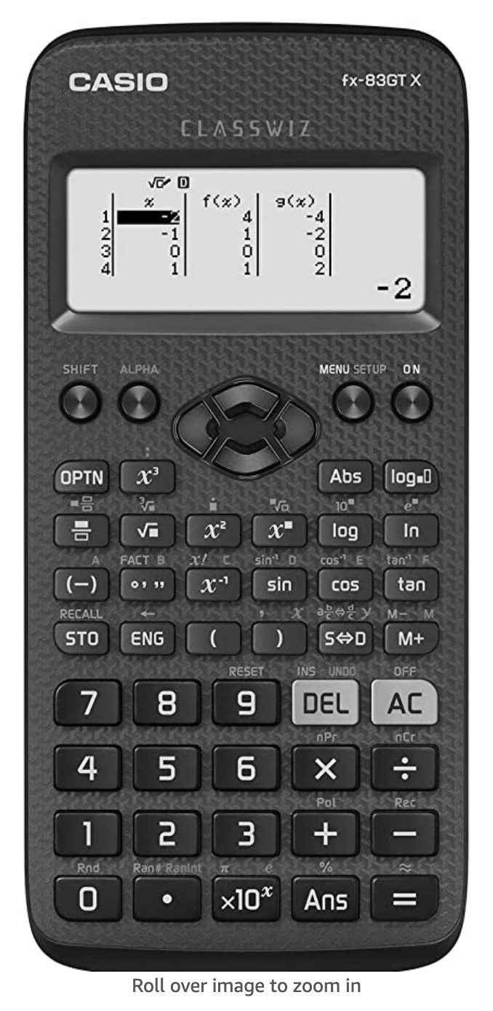
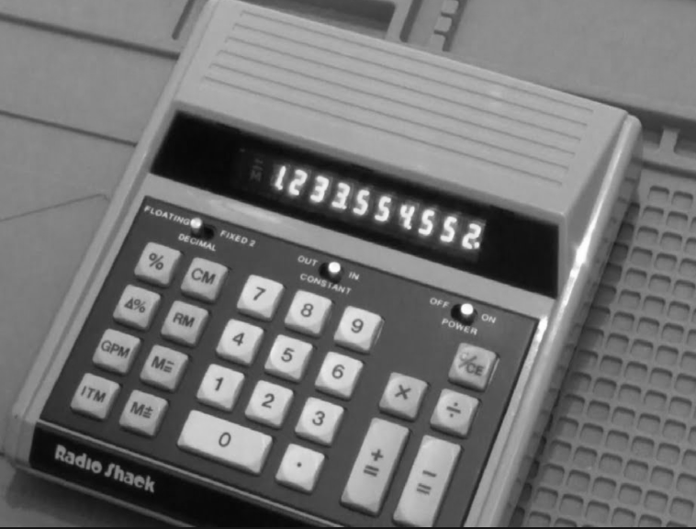
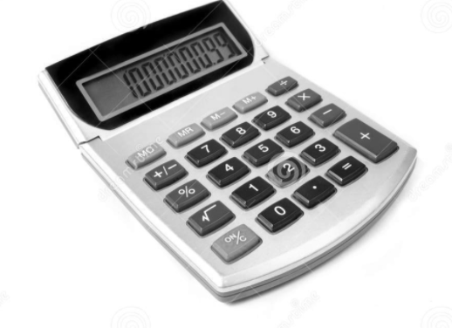
The calculator transformation .
In his short 39 years of life, Blaise Pascal made many contributions and inventions in several fields. He is well known in both the Mathematics and Physics disciplines. In Mathematics, he is known for contributing to Pascal's triangle and probability theory. He also invented an early digital calculator and a roulette machine.
Pascal’s calculator
The calculator we use in school
The modern calculator can now be found everywhere (both mini and large versions) and is embedded into devices such as laptops and mobile phones. How many devices that have calculators can you find in your house?
Mr. Bingham’s favourite Mathematician

Slide 11
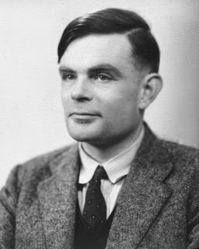
Code Breaking…
Mr Tonks’ favourite Mathematician
Alan Turing
Alan Turing was a British Mathematician. He made major contributions to the fields of Mathematics, Computer Science, and Artificial Intelligence. He worked for the British government during World War II, when he succeeded in breaking the secret code Germany used to communicate.
In September 1939 Great Britain went to war against Germany. During the war, Turing worked at the Government Code and Cypher School at Bletchley Park. Turing and others designed a code-breaking machine known as the Bombe. They used the Bombe to learn German military secrets. By early 1942 the code breakers at Bletchley Park were decoding about 39,000 messages a month. At the end of the war, Turing was made an Officer of the Most Excellent Order of the British Empire.
Can you crack the codes?
A | B | C | D | E | F | G | H | I | J | K | L | M
55 | 47 | 84 | 10 | 9 | 75 | 59 | 64 | 32 | 15 | 23 | 50 | 26
N | O | P | Q | R | S | T | U | V | W | X | Y | Z
80 | 63 | 19 | 3 | 27 | 30 | 21 | 92 | 18 | 35 | 99 | 69 | 199
85 – 62 =
9 x 3 =
200 $÷$ 4 =
18 + 45 =
73 – 14 =
135 $÷$ 5 =
27.5 x 2 =
6² – 10 =
5 $×$ 11 =
252 $÷$ 3 =
107 – 15 =
7 x 3 =
72 $÷$ 8 =
5 x 2 =
19 + 13 =
36 $÷$ 2 =
24 + 8 =
60 $÷$ 6 =
28 – 19 =
Can you make up some calculations to spell out your name using the same code breaker grid?
Can you make up your own message for a friend to decode?

Slide 12
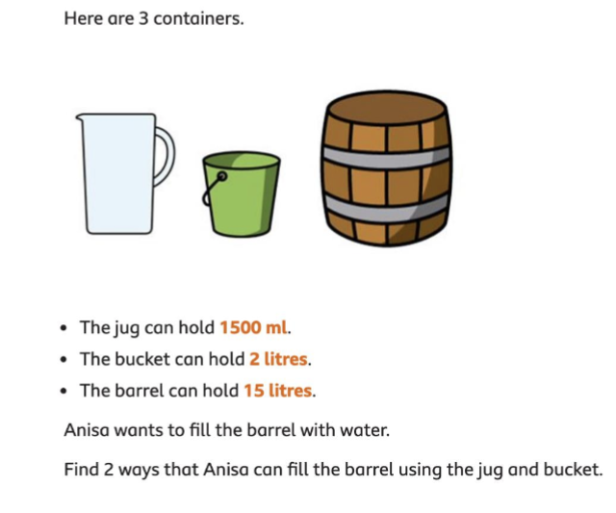
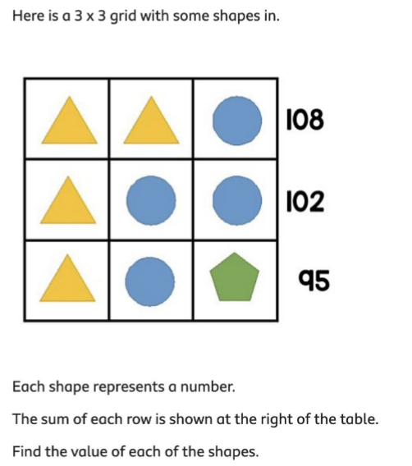
Maths Challenges…
Can you solve all the Maths challenges?
They get more difficult as you go along...

Slide 13
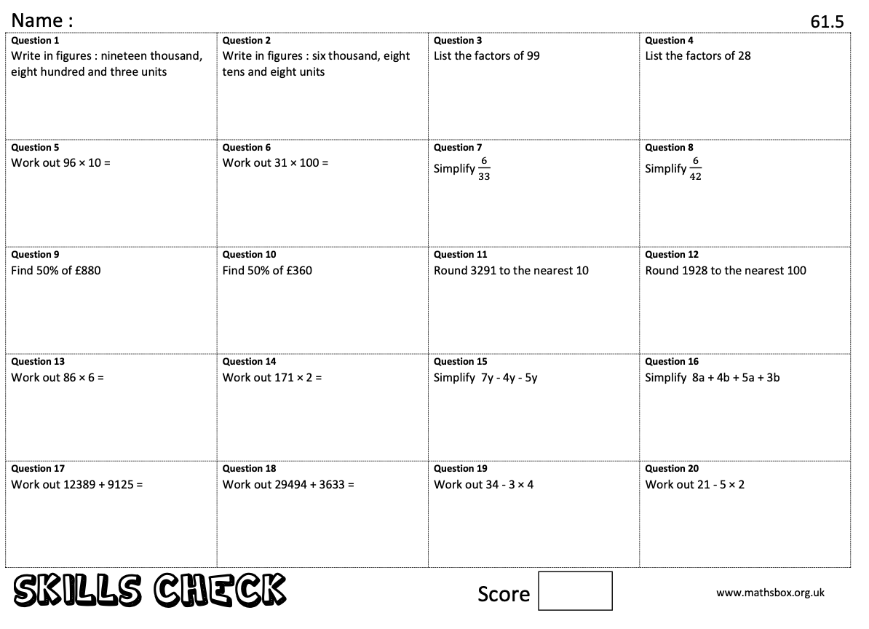
Key Skills…
When you get to a page like this, spend 10 minutes completing
the skills check questions based on topics from Y6.
René Descartes
Descartes is considered the father of modern Philosophy, a key figure in the scientific revolution of the 17th century, and a pioneer of modern Mathematics. Many people also call him the father of analytic geometry, which connects the fields of algebra and geometry.
Mr.Cowlinshaw’s favourite Mathematician

Slide 14
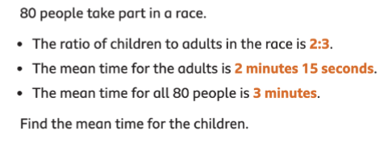
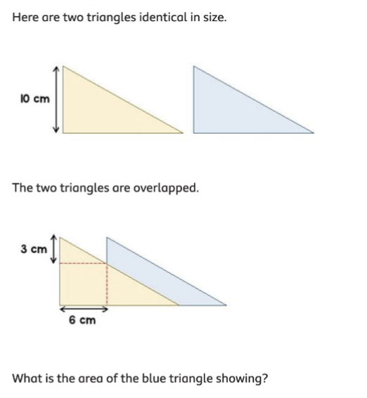
Maths Challenges…
Can you solve all the Maths challenges?
They get more difficult as you get them..

Slide 15
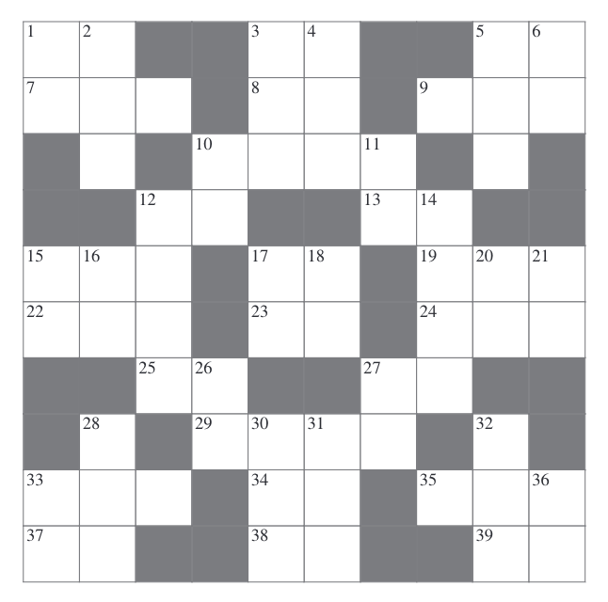
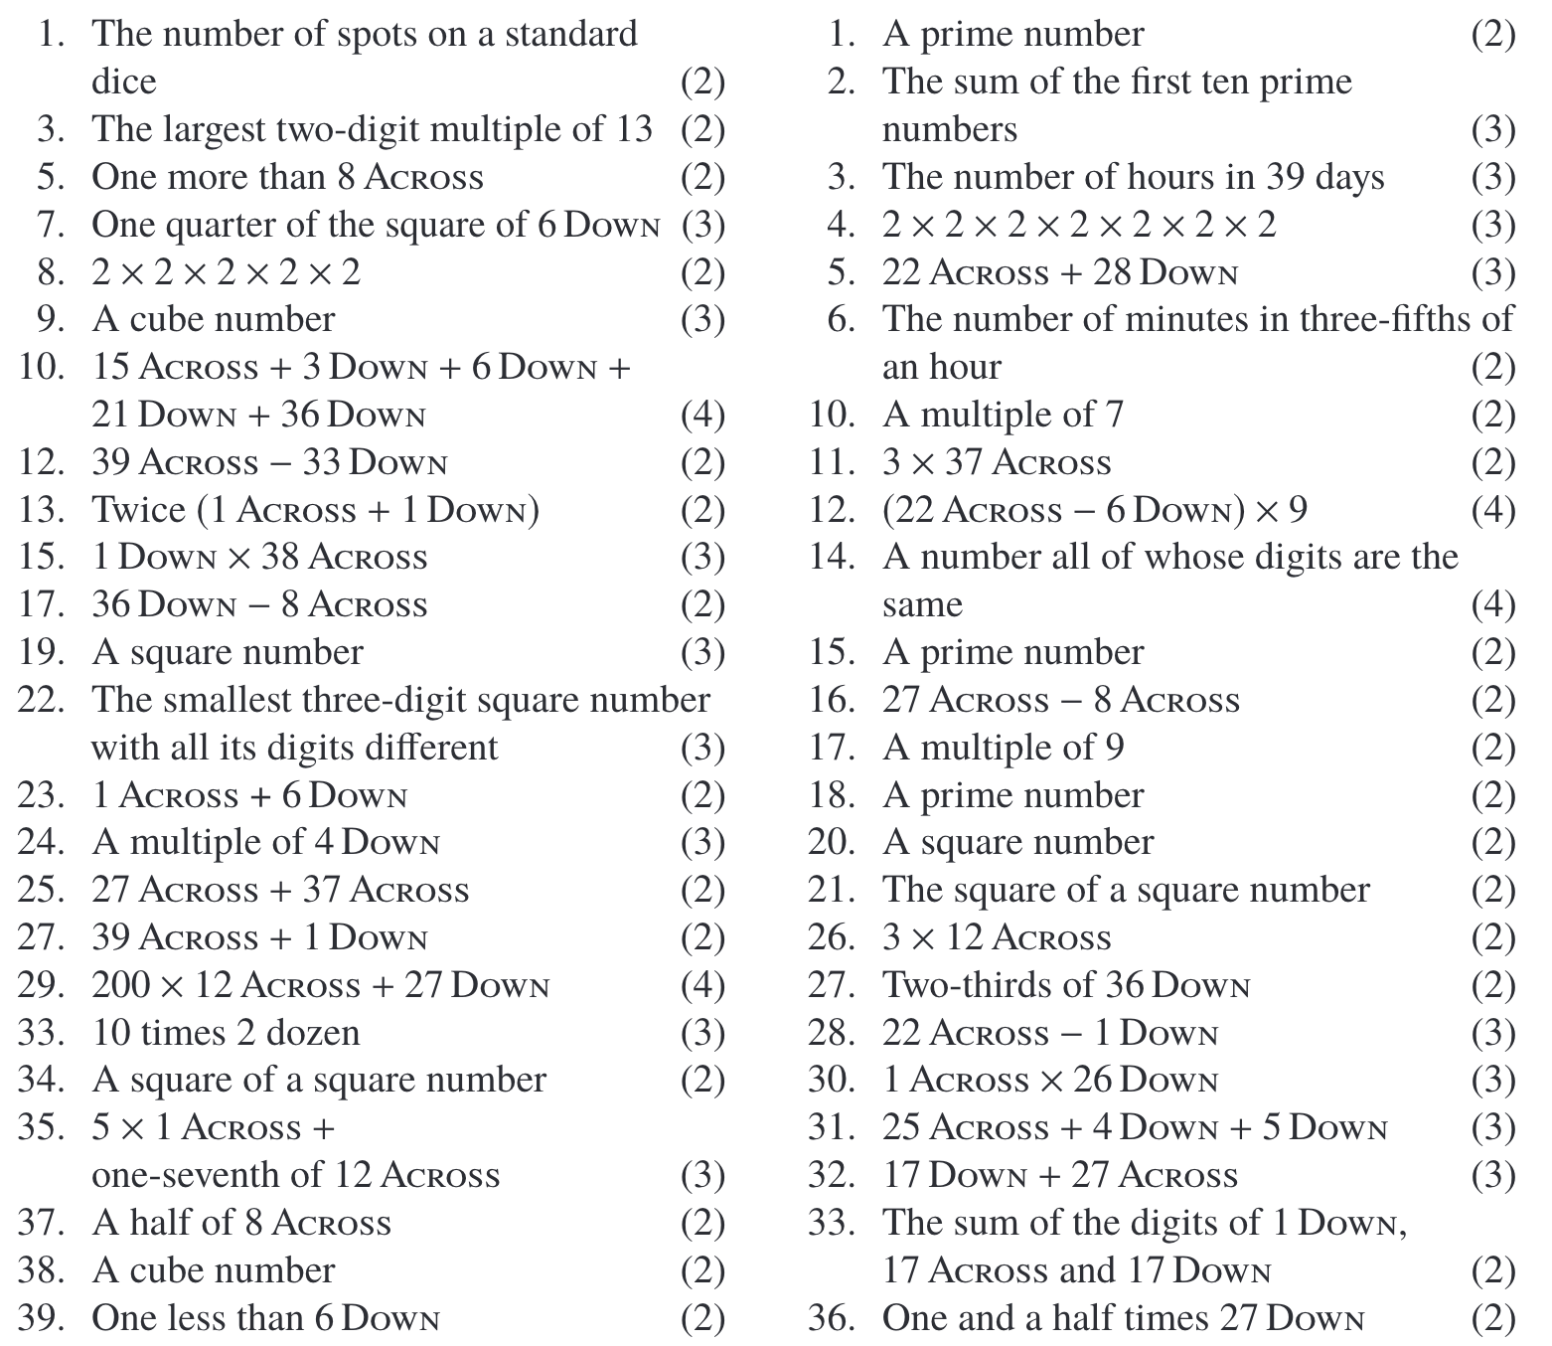
Cross Number…
Use the questions below to complete the cross number.
2
1
Across
down

