Slide 1

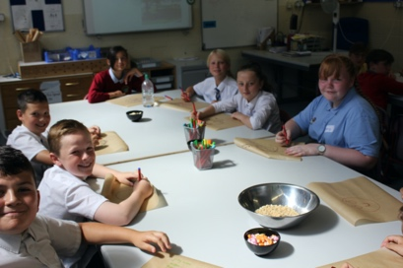
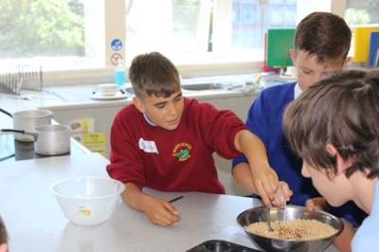
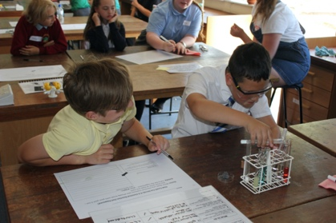
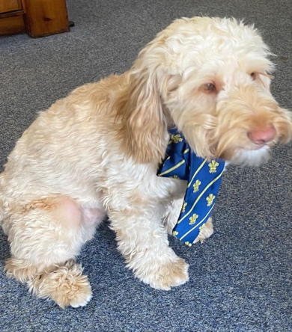
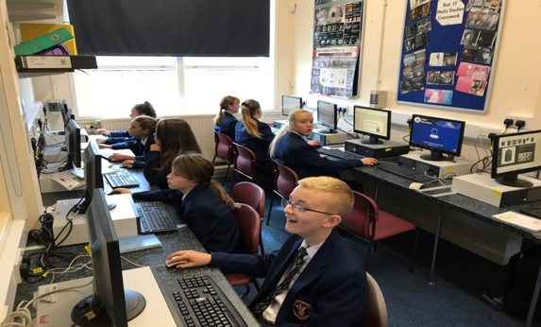

Moving Up
Ysgol Rhiwabon
Transition Booklet 2020

Slide 2
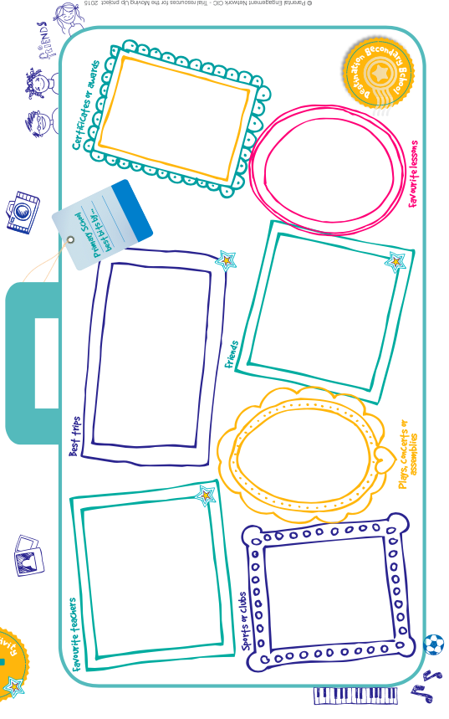
Primary School Memories

Slide 3
Primary School Memories
Take a trip down memory lane with your family. It’s important when you have a big change to think about what you are leaving behind – it’s a big thing to leave primary school. Hunt out drawings, photos, certificates, and awards of your life in primary school
Talk to a member of your family about your memories of Primary School right from when you started in nursery or reception. Here are some questions you might want to start with...
Which events, trips, plays, assemblies, sports, and music activities do you remember?
What lessons have you enjoyed the most? (or the least?)
Who have been your best friends at primary, how long have you known them?
Who were your favourite teachers/ helpers?
What is your favourite memory?
Can you think of a time when something made you laugh? Or made you worried or scared?
What has been your proudest moment or achievement?
Then ask your family about their memories of primary school
Write down your family’s memories here

Slide 4

Ysgol Rhiwabon:
School Information
Get in touch
Address
Ysgol Rhiwabon
Pont Adam,
Ruabon
Wrexham, LL14 6BT
Telephone: 01978 822392
Email: mailbox@rhiwabon-high.wrexham.sch.uk
School Day
REG | 8.50 am – 8.55 am
Lesson 1 | 8.55 am – 9.55 am
Lesson 2 | 9.55 am – 10.55 am
BREAK | 10.55 am – 11.10 am
Lesson 3 | 11.10 am – 12.10 pm
Lesson 4 | 12.10 pm – 1.10 pm
LUNCH | 1.10 pm – 1.40 pm
Form | 1.40 pm – 2.10 pm
Lesson 5 | 2.10 pm – 3.05 pm

Slide 5
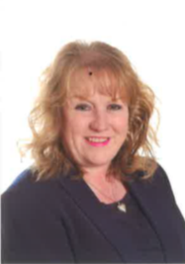
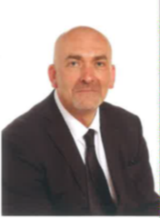
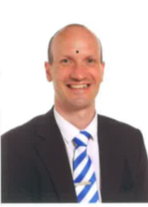
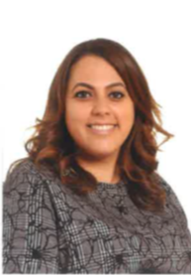
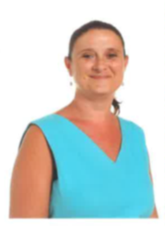
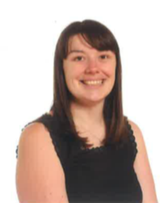
Ysgol Rhiwabon:
Key Staff
Mrs Ferron-Evans
Head Teacher
Mr Forman
Assistant Head Teacher
Mr Bingham
Assistant Head Teacher
Mrs Savva
Assistant Head Teacher
Mrs Navarro
Additional Learning Needs Co-ordinator
Mrs Wright-Davies
Year 7 Lead Learner

Slide 6
Ysgol Rhiwabon
Full Name of the School
School Address
School Telephone Number
Name of the Head Teacher
Name of Lead Learner
School Starts at
School Finishes at
I will get to school by
Add 10 words around the image to describe your new school .

Slide 7
All About Me
I am happiest when ………………………………………………
I would most like to be ……………………………………………
At secondary school I am looking forward to ………………
…………………………………………………………………………
I am most relaxed when…………………………………………
My favourite food is………………………………………………
My favourite music is……………………………………………..
My favourite sport is………………………………………………
My favourite programme is……………………………………..
My favourite colour is…………………………………………….
My favourite place I’ve been is………………………………..
Three things I like to do when I’m not in school:
………………………………………………………………………..
……………………………………………………………………..…
………………………………………………………………………..

Slide 8
How Do You Feel?
When you think about changing school there will be things you are nervous about and things that you are not.
Using two different colours, colour the boxes in.
One to highlight the phrases you are not worried about and the other colour to highlight the phrases you are worried about.
Being with friends
School rules
Homework
Break times
Making new friends
Getting to school
Being on time
Being with older pupils
Dinner time
Managing a money less system to pay for food.
Finding way around
Meeting my new tutor
Having a different uniform
Managing a timetable
Being able to do the work
Meeting my new teachers
Learning new subjects
Getting changed for sport / PE
Meeting others my own age

Slide 9
How Do You Feel?
List 3 things you are excited about moving to Ysgol Rhiwabon
List 3 things you would like to know about Ysgol Rhiwabon
List 3 things that will help you when moving to Ysgol Rhiwabon
List 3 differences between primary school & Ysgol Rhiwabon

Slide 10
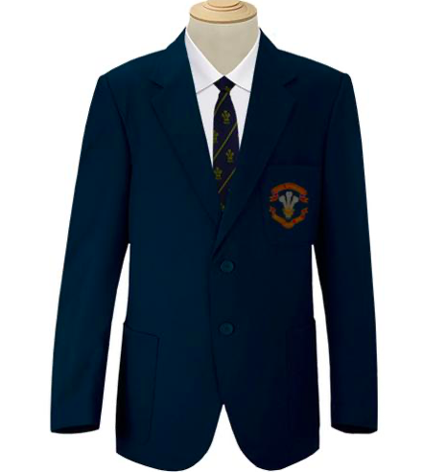
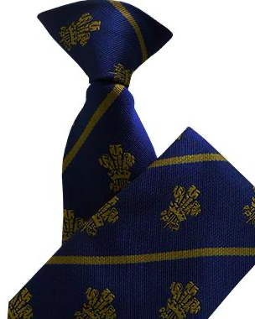
Ysgol Rhiwabon:
School Uniform
Schools have different uniforms for lots of different reasons. It shows other people which school you go to, and it saves having to decide what to wear each school day!
Remember to write your name in all your uniform in case it gets lost
My uniform shopping list
Ysgol Rhiwabon Blazers
£26.00
Ysgol Rhiwabon
Clip-on Tie
£5.50
Black tailored trousers
Black knee length skirt
Black V neck jumper
(no logo
& optional)
All black leather school shoes
(no logos)
White shirt

Slide 11
Ysgol Rhiwabon:
PE Kit
Schools have different PE kits for indoor and outdoor activities
My PE kit shopping list
Remember to write your name in all your kit in case it gets lost
Games Kit
Black shorts
Football boots
Black tracksuit (winter)
Trainers
Games Kit
Plain white T-shirt
Black shorts
White socks
Black tracksuit
Trainers
Ysgol Rhiwabon
Football Kit
£12.00
(boys)
Red Football Socks
£4
(boys)
Gym Kit
Plain white T-shirt
Black shorts
Black tracksuit
Trainers
White socks
Gym Kit
Plain white T-shirt
Black shorts
Black tracksuit bottoms for winter
Trainers

Slide 12
Ysgol Rhiwabon: Equipment
What you need to take to high school will be different from primary school – you may also need a bigger bag as you will be carrying lots of things around with you as you move to different classrooms.
Tick in the box, which of these objects will you need (and be allowed) to take to your new school. If you’re not sure put a ? and check when you start at school in September.
Pens
School
books
Calculator
Lunch
Dictionary
Planner
Chewing gum
Pencils
Water bottle
Cuddly toy
Ruler
Shopping List – what do I need to get?
Mobile
phone
Money
House key
Ear phones
Make up
School bag

Slide 13
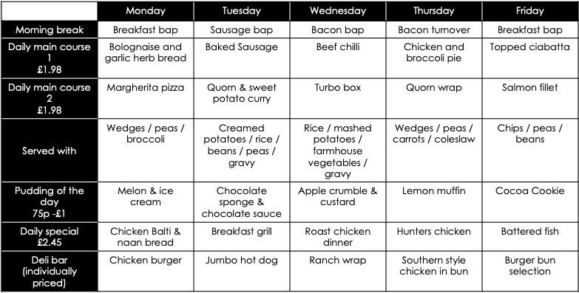
Free School Meal students get a daily amount pre-paid onto their account
WCBC School Dinners
Breakfast – also available - breakfast panini; cheese toasty; toasted teacakes; crumpets; bagels; beans on toast; toast; French bread pizza/piazzini.
Lunch - also available – filled jacket potatoes, boxed salads, sandwiches, baguettes, wraps, Theo’s,
panini’s, Chicago Town pizza, pasta pots.
Dessert choice 59p - £1 – Assorted cookies; cakes; welsh fruit yoghurt; fresh fruit.
Drinks 59p - £1.23 – Milk; water; fruit juice; hot drinks.
Daily main course and pudding of the day £2.45.
As an alternative to you can choose either a piece of fresh fruit or a 200ml fruit juice.

Slide 14
Ysgol Rhiwabon:
School Day
School starts at:
Break starts at:
___ ___ : ___ ___
___ ___ : ___ ___
Lunch starts at:
School finishes at:
___ ___ : ___ ___
___ ___ : ___ ___

Slide 15
Ysgol Rhiwabon:
School Timetable (example)
Week A | 1 | 2 | 3 | 4 | 5
Mon A | Maths JTP E5 | Science DCS S8 | English CRD E4 | RS MJR G3 | Welsh EDH E6
Tues A | Maths JTP E5 | Welsh EDH E6 | History VWD G1 | Science DCS S8 | Art LMJ T7
Weds A | ICT EMT T9 | Maths JTP E5 | History VWD G1 | Science DCS S8 | English CRD E4
Thurs A | PE AJ SH | Science DCS S8 | RS MJR G3 | Art LMJ T7 | French SE E5
Fri A | PE AJ SH | Geography JGH G8 | Maths JTP E5 | Technology DRT T12 | English CRD E4
Week B | 1 | 2 | 3 | 4 | 5
Mon B | English CRD E4 | History VWD G1 | Art LMJ T7 | Science DCS S8 | Welsh EDH E6
Tues B | Geography JGH G8 | Science DCS S8 | PE AJ SH | ICT EMT T9 | Music SVT MR
Weds B | Maths JTP E5 | English CRD E4 | French SE E5 | RS MJR G3 | PE AJ SH
Thurs B | Geography JGH G8 | English CRD E4 | Maths JTP E5 | Technology DRT T12 | Music SVT MR
Fri B | French SE E5 | Technology DRT T12 | Maths JTP E5 | English CRD E4 | Science DCS S8

Slide 16
Ysgol Rhiwabon:
Understanding School Timetable
Using the timetable on the previous page answer the questions based on it.
What subject would you have Monday Week A lesson 1? ………………………….......................................
Who is the teacher of Technology? …………………………………………………………………
What room does Ms Gittins teach in? …………………………………………………………………
What subject would you have Thursday Week B lesson 4? ……………………………………………………
What room does Mrs De Rosa Herd teach in? …………………………………………………………………
Who is the teacher of English? …………………………………………………………………
What subject would you have Wednesday Week A lesson 5? ………………………………………………………
Teacher initials list:
AJ – Mrs Jones EDH – Mrs De Rosa Herd
JTP – Mr Tonks VWD – Mrs Wright-Davies
DCS – Mr Cowlishaw LMJ – Mrs Madoc-Jones
CRD – Mrs Davies EMT – Mrs Thomas
MJR – Mr Jones SE – Mrs Evans
JGH – Ms Gittins DRT – Mr Roberts
SVT – Mrs Tarver

Slide 17

Ysgol Rhiwabon: Expectations
The expectation that we have is that we all behave in a way that means that we are calm, collected and respectful towards one another, and that we arrive for our lessons punctual and prepared.
CPR
Calm & Collected
Punctual & Prepared
Respectful & Responsible
Match the correct description to each letter of the CPR policy
Turning up on time to lessons
Working successfully as part of a team
Being respectful of other peoples beliefs
Having your shirt tucked in neatly
Contributing to lessons
High level of respect shown to all
Saying good morning to people as you pass
Supporting others
Holding the door open for a teacher
Having a pen, pencil and ruler in lesson
Consistent punctuality over the whole year
Helping with Breakfast Club
Turning up on time to lessons
Acting as an ambassador role
Going above and beyond with your work
Staying calm if something goes wrong
Being respectful to other staff and students
Sitting with someone who is alone at lunch
Apologising if you have done something hurtful
Turning up on time to lessons
Discussing issues with a teacher rather
Remembering your homework
Giving someone a compliment
Asking for help when needed

Slide 18
Ysgol Rhiwabon:
Fact or Fiction
Sometimes, older children you know might tell you things about Secondary School that might worry you. They sometimes do this to tease you, see your reaction or to make you think it will not be a very nice place to go.
So it is important that you do not believe everything you hear without finding out what is true - FACT. FICTION is something that is made up.
FICTION – Stories told by others | FACT – the Truth
You get at least three hours homework every night, even at weekends.
You won’t know anyone and it will be really hard to make friends
If you can’t do your homework you will get two hours detention.
You have to pay £1 fine every time you don’t wear the right uniform or you forget to bring an item in
It is difficult to find your way around and you will be lost constantly
The teachers are mean and don’t listen to your problems

Slide 19
Ysgol Rhiwabon:
2 Truths, 1 Lie
In each box below you will have a different situation with 3 options, two are the truth and one is a lie. You need to work out which are the truths and which is the lie.
If I can’t find my way to class Ask someone in my class. Ask a teacher, TA or someone in the Office Do nothing and keep walking around | If I arrive late Wait until the lesson is over and go to the next one. Go to the office and sign in. Go straight to my lesson and tell the class teacher.
If I forget my homework Ask the office to call home Never do it Tell the subject teacher before the lesson (if possible) and bring it in the next school day. | People who can help me Form Tutor Nobody Lead Learner
If I forget my PE Kit Tell my Form Tutor Ask the office to call home to see if it can be brought in Do nothing | If I forget my lunch Tell my Form Tutor. Ask the office to call home to see if it can be brought in Nothing, I just won’t eat
If the person picking me up is late Go to the office and they will call the person picking me up. Just wait, someone will come… Walk home without speaking to anyone | If I forget my tie Tell my Form Tutor Ask the office to loan me one and return it at the end of the school day. Don’t bother, it’s only a tie

Slide 20
Ysgol Rhiwabon:
Goal Setting
When you go to Secondary School, you will learn and improve skills you have practiced in Primary School. In the goal, use the list to write in skills or things you’d like to learn or build on during your time in Ysgol Rhiwabon
Learn to play a musical instrument | Volunteer in the local community | Travel to another country
Play for a school team | Speak another language | Take care of the school garden
Learn how to manage money | Taste food from another country | Walk the school dog
Cook a new meal from scratch | Read new books | Take part in a fancy dress day
Create a piece of art | Raise money for charity | Become Head Boy or Girl
Learn how to read a map | Join an after school club | Learn to dance
Use computers to create your own website | Represent your school in a national competition | Improve your singing
Make new friends from other schools | Work as part of a team | Be in a school play or production

Slide 21
Keeping Healthy & Safe
Screen Time
It’s very important to agree on how much time you will spend on screen and how to keep safe. Make an agreement together – and for things to think about see the bubbles below:
1. Being on the phone e.g. at mealtimes
Screen Time Agreement
4. Hours watching TV
1…………………...
2…………………...
3…………………...
4…………………...
5…………………...
2. Use of social media and settings
5. Stopping screens an hour before bedtime
3. Playing computer games
Keep a record of exercise you have taken over the summer holidays and any family members that have been involved
Date | Exercise | How long for? | With family?

Slide 22
Ysgol Rhiwabon:
School Subjects
M | A | F | S | E | H | M | G | E | O | H | I | M | J | R | E | A
F | M | A | M | W | S | L | U | S | M | I | S | E | T | E | I | S
R | U | D | A | S | C | E | Z | S | A | C | P | N | U | L | A | I
A | F | G | T | R | D | P | W | R | I | I | A | G | T | I | N | U
H | S | R | H | P | G | R | T | E | N | C | I | T | O | G | A | O
J | T | A | S | L | U | B | N | Y | R | A | N | E | R | I | S | L
T | U | B | J | E | I | C | Q | L | E | R | M | X | T | O | S | F
E | E | A | U | H | E | M | U | A | H | S | U | D | I | U | E | R
N | F | C | L | G | E | O | G | R | A | P | H | Y | M | S | M | E
G | I | M | H | V | M | A | I | T | R | E | O | A | E | S | B | N
L | O | A | I | N | O | T | O | H | T | T | T | S | C | T | L | C
I | P | T | E | E | O | G | R | D | U | O | E | R | A | U | Y | H
S | P | U | F | O | S | L | E | K | C | M | P | T | T | D | E | M
H | I | S | T | O | R | Y | O | C | S | A | S | M | E | I | R | A
E | N | J | V | E | P | I | F | G | N | O | U | U | R | E | B | K
C | G | T | A | R | I | B | G | L | Y | C | N | A | R | S | U | M
Y | Z | X | T | L | S | V | Z | C | O | M | P | U | T | I | N | G
Maths
English
Science
Geography
History
Art
Music
PE
Technology
Computing
Religious Studies
French
Assembly
Tutor Time

Slide 23










Ysgol Rhiwabon:
School Subjects
Match up the subject to the correct icon
Maths
English
Science
Geography
History
Art
Music
PE
Technology
Computing
Religious Studies
French
Tutor Time

Slide 24
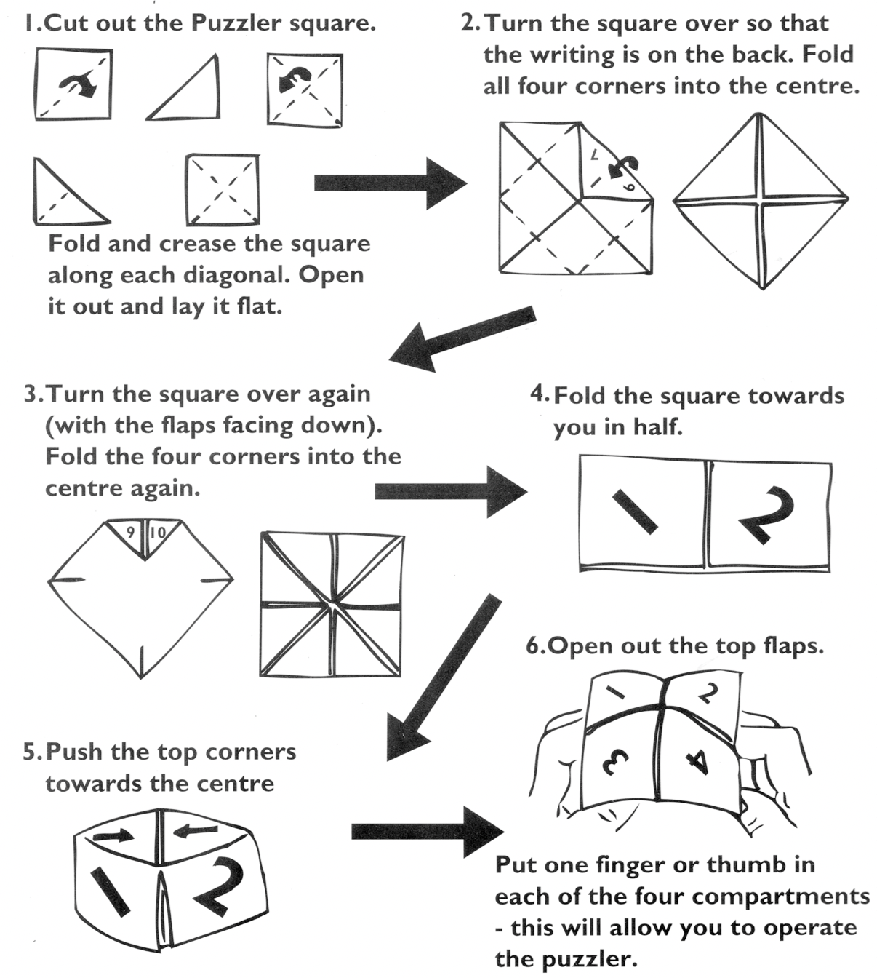
Ysgol Rhiwabon:
Coping with Change
Using the template on the next page

Slide 25
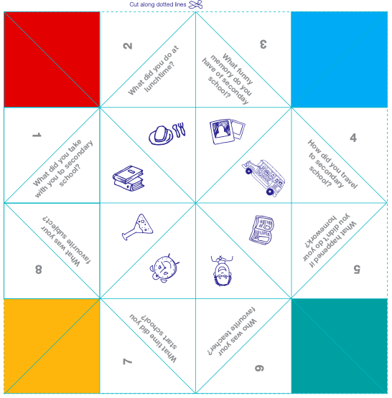
Ysgol Rhiwabon:
Coping with Change
Follow instructions on the previous page

