Slide 1
Revision KQ4
Discuss
How did the Nazis consolidate their power between 1933 and 1934?
MLO: To use and consolidate knowledge about how the Nazis consolidated their power between 1933 and 1934

Slide 2
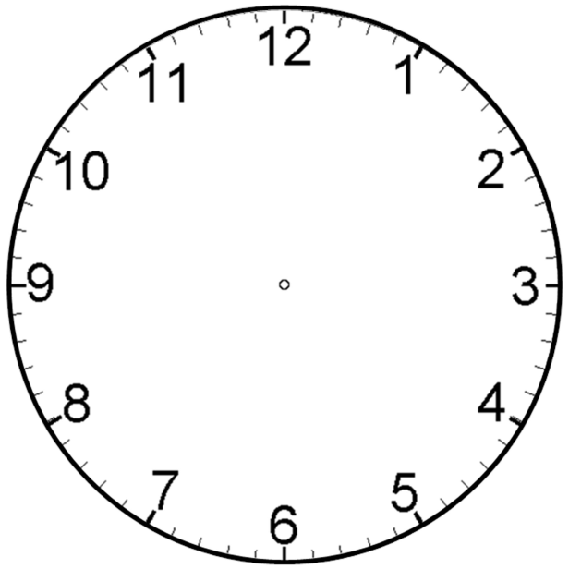
Hitler as Chancellor
Reichstag Fire
KQ4 –
Consolidation of Power
Hitler become Fuhrer
1933 Election & Enabling Act
Night of the Long Knives
Trade Unions & Political Parties

Slide 3
Chancellor to Dictator
Chancellor
Has some power in his hands
There are several parties
Has to pass laws with Parliament’s agreement
Citizens can only be arrested if they break a law
Usually rules peacefully
Dictator
Can pass any law without Parliament
Can arrest citizens without reason
Often uses violence to rule
There is only 1 Party
Has all power in his hands

Slide 4
Reichstag Fire
February 1933
The Reichstag building burnt down.
A communist was found inside the building. He admitted responsibility.
Chancellor Hitler was able to convince people that the Communists were trying to take power by terrorism.
He was able to have the Communists banned from the Reichstag.

Slide 5
March Election & Enabling Act
March election: SA intimidated members as they voted
Hitler banned communists from voting for it in March 1933
When it was passed it allowed him to establish his dictatorship.
Hitler can rule alone for four years. There is no need to consult the Reichstag
Marked the end of Weimar Constitution
Banned political parties
Trade Unions
Control of the press

Slide 6
Trade Unions
2nd May 1933 all trade unions were banned.
Nazis said they were not needed as everybody was part of the Volksgemeinschaft (peoples community)
Set up DAF (German Labour Front)
Strikes were outlawed
Any opposition were sent to new prisons (concentration camps)
Some union leaders were immediately sent to concentration camps

Slide 7
Political Parties 1933
Communist Party = banned in March
SDP had HQ, property and newspapers seized May.
End of June/July - remaining political parties voluntarily disbanded themselves
14th July 1933 = Law Against the Formation of Parties
Nazi Party the only legal political party.
November 1933 election Nazi = 95.2% (other papers = spoilt)

Slide 8
Night of the Long Knives
June 1934
Got rid of opposition political groups (with Enabling Act & Reichstag Fire)
Now to deal with opposition in my party.
Ernst Rohm, head of the S.A. very unpopular with the German army leaders.
Hitler had to get rid of Rohm. He was too much of a threat.
On the night of 30th June 1934 Hitler’s S.S. killed over 1000 SA members including Rohm.
The army were pleased.
Hitler had gained the support of the army.

Slide 9
Death of Hindenburg
August 1934
President Hindenburg’s death gave Hitler the opportunity to combine the role of chancellor
And president.
He called himself ‘der Fuhrer’.
Final thing he needed the army swear an oath of loyalty to Hitler

Slide 10
Was the Enabling Act the most significant event in Hitler’s consolidation of power? [16 + 3]
Event in consolidation of power | Why was it significant in Hitler becoming Fuhrer?
Enabling Act
Reichstag Fire
Night of the Long Knives
Banning of political parties & trade unions
Death of Hindenburg

