Slide 1
Revision KQ3
Discuss
How and why did the Weimar Republic collapse between 1929 and 1933?
MLO: To use and consolidate knowledge about the end of Weimar and answer exam questions

Slide 2
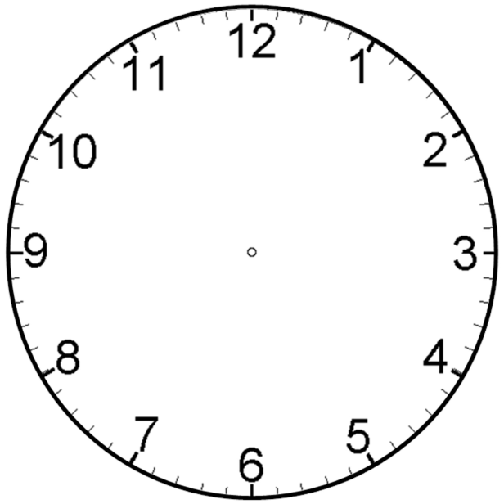
Social & Political impact of Depression
Reasons for growing support for Nazis
KQ3 –
End of the Weimar Republic
Any key people
Role of the SA
Political Extremism & Scheming 1929-32
Propaganda

Slide 3
Social impact of Depression
Unemployment rose
Factories closed
Farmers affected by falling food prices
Some Germans unable to pay rent – homeless
Hungry
Threat of benefits being cut

Slide 4
Political impact of Depression
Government not solving problems
People turning to extremist parties
People turning to those who offered solutions to their suffering
Nazis and Communists promised a way out of the depression

Slide 5
Hitler and Nazi appeal
Gifted public speaker
Projected the image of being the messiah – who would solve all of Germany’s problems
Used private plane to tour the country delivering speeches to mass audiences
Offered things to all sections of society
Blamed the Jews & communists

Slide 6
The role of the SA
The SA played a part in the Nazis’ increasing popularity by:
intimidating the Nazis’ political opponents – especially the communists – by turning up at their meetings and attacking them
providing opportunities for young, unemployed men to become involved in the party
protecting Hitler and other key Nazis when they organised meetings and made speeches
By 1932, there were 400,000 members of the SA.

Slide 7
Propaganda
March 1934 – Ministry for Popular Enlightenment and Propaganda was set up.
Josef Goebbels head of propaganda
Aim – to control the thoughts, beliefs and opinions of the German people.
Brainwashed them through a variety of methods:
Posters
Rallies
Radio
Cinema
Art & architecture
Kept messages simple and appealed to all people in society offering them hope in a time of crisis

Slide 8
Political Scheming
Article 48 – President could over rule parliament (rule by decree)
Hitler could not get an overall majority
Von Papen in charge -> Hindenburg didn’t want Hitler in charge.
Von Papen was replaced with Schleicher
Von Papen worked with Hitler
Schleicher couldn’t solve economic issues.
Von Papen persuaded Hindenburg to allow Hitler as Chancellor
Von Papen and Hindenburg believed they would be able to control Hitler and use him as a puppet

Slide 9
To what extent was Nazi propaganda the main reason why Hitler became Chancellor of Germany in January 1933? [16 + 3]
Reason for rise to power | Why did it lead to them getting into power?
Propaganda
Impact of the Depression
SA
Hitler’s appeal
Political Scheming

