Slide 1
GCSE Germany Introduction
You are to complete the mind map on the next slide using the information on the slides that follow.
You can either print out slide 2 and fill it in, or just copy it out on paper

Slide 2
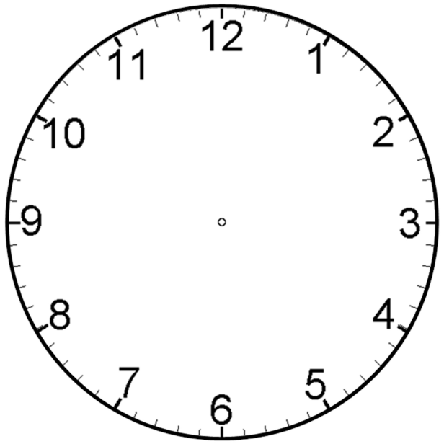
Recovery from hyperinflation
Dawes & Young Plans
KQ2 –
Recovery of Weimar
Social & Political developments
Locarno Pact & Kellogg-Briand Pact
US investments
League of nations

Slide 3
Recovery from Hyperinflation
Gustav Stresemann was made chancellor in August 1923 (for 100 days) and confronted all the problems e.g. hyperinflation, Ruhr, opposition from left and right
Nov. 1923 to restore confidence in the German currency, Stresemann introduced a temporary one - the Rentenmark.
Issued in limited amounts and based on property values rather than gold reserves.
Restored the confidence of the German people in the currency.
In the following year, the Rentenmark was converted into the Reichsmark, a new currency now backed by gold reserves.

Slide 4
Dawes Plan
US vice-president Charles Dawes led the plan
Re-organised reparation payments and reduced reparations – a fixed annual scale meaning Germany could afford to pay.
Germany had to pay 2.5 million marks a year
France withdrawing from the Ruhr
USA to make loans to Germany in order to kick-start the German economy.
The plan was accepted by the Allies and came into effect in September 1924

Slide 5
Young Plan
1929 Owen Young asked to investigate the payments and came up with a new plan.
Made further changes to the reparations plan, which helped Germany.
Reparations reduced from £6600m to £1850m
Reduced reparations to 2 million marks a year
Extended the time Germany had to pay – 59 years (1988)
French agreed to withdraw from the Rhineland 5 years earlier than stated in the Treaty of Versailles.

Slide 6
Locarno Pact
Stresemann wanted to improve relations with France and Britain
France needed to feel secure in order to co-operate with changes to T of V
1925 signed with Britain, France, Belgium & Italy
To keep existing borders to the west
Marked Germany’s return to European international scene & saw co-operation with France & Britain

Slide 7
Kellogg-Briand Pact
1928 Germany signed the Kellogg-Briand Pact with 64 other nations.
Agreed that they would keep their armies for self-defence and solve international disputes ‘by peaceful means’.
It showed further improved relations between the USA and the leading European nations and highlighted that Germany was once again one of these.

Slide 8
League of Nations
Germany needed to be a member for Locarno Pact to happen
1926 Germany allowed to join
Stresemann seen as a hero
An international organization, created after the First World War for resolving international disputes.

Slide 9
US Investments
The Dawes Plan also aimed to boost the German economy through US loans
First loan was 800m marks.
Over next 6 years, US companies and banks gave loans of nearly $3000m.
US investment not only helped economic recovery, but also enabled Germany to meet the reparations payments

Slide 10
Social Developments
Wages – many improved by 10%, some of the highest paid workers in Europe, middle class did not benefit, unemployment highest in professions such as lawyers & teachers.
Housing – shortage in many parts of Germany, invested money into building new homes. Homelessness reduced by more than 60% by 1928
Unemployment insurance – benefits to war veterans, single mothers & disabled
Women – improvements in role of women, gained the vote, equal pay, more jobs – bigger advances than most European countries

Slide 11
Political Developments
1924-29 saw greater political stability.
Due to Stresemann (Foreign Minister) & Hindenberg (President)
Less support for extremist parties e.g. Nazis
BUT:
Still no single party majority meaning still a coalition government

