Slide 1
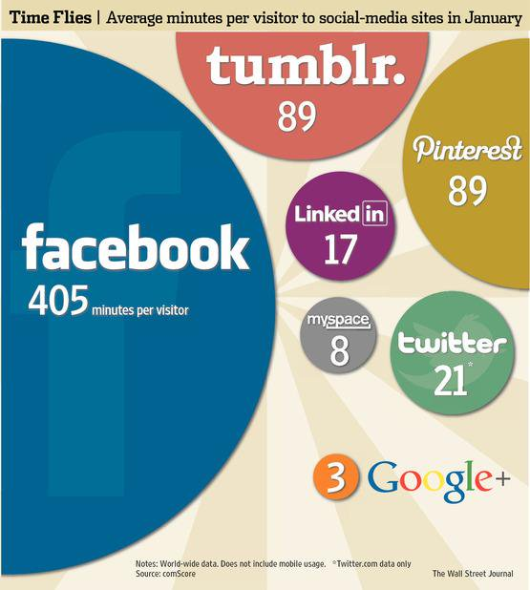
Question Type – infographic (1 mark)
What social media site received the lowest amount of visitors in January?
Google+
What was the fourth most popular social media site in January?
Twitter

Slide 2
Question Type – infographic (1 mark)
What is the least popular sport?
Athletics

Slide 3
Question Type – infographic (1 mark)
As a fraction, how much of the food produced in the UK is eaten?
1/4

Slide 4
Question Type – definition of term (1 mark)
The following extract is from an essay, “The Revenge of the Couch Potato”, written by Candida Crewe
I have hated exercise all my life, but recently I have felt the need to reconsider my entrenched views against physical activity. This would almost certainly never have been the case had obesity not been in the news daily of late and, more crucially, had I not given birth to three boys who have no truck whatever with keeping still.
Select the correct definition for the term ‘entrenched’
Old fashioned
Engrained
Negative
Positive

Slide 5
Question Type – definition of term (1 mark)
The following extract is from a leaflet, ‘Skipton Castle’ produced by Skipton Castle
Skipton also has a very wide selection of facilities including numerous pubs, places to eat and shops. Visitors from all over the country never cease to marvel at the magnificent glass roofed arcade with its decorative ironwork.
Select the correct definition for the term ‘marvel ’
Look
Study
Be astonished
Notice

Slide 6
Question Type – location (2 marks)
Find two things the text says about what can happen to animals if they’re abandoned.
We know that sometimes people’s circumstances change and they can no longer look after their pet. At Blue Cross we never judge anyone for making the responsible decision to give up their animal and we’ll do what we can to help.
No matter how desperate you’re feeling, please don’t dump or abandon your pet, even outside a Blue Cross centre. This is incredibly traumatic for them and also very dangerous – they could become seriously ill, potentially die or they could escape and be hit by a car. It also means that even if they are found and brought to us, we won’t know their history, which makes it a lot harder to find them the right home.

Slide 7
Question Type – definition of term (1 mark)
This passage is about a swimming race in the sea between two friends called Ian and Ollie
Ollie,’ I cried, the race forgotten, terrified I was going under. Panic should have meant an adrenalin surge but the gap remained the same and I subsided to a weary doggypaddle. Cold and exhausted and resigned to defeat
Select the correct definition for the term ‘subsided ’
Lessen
start
Intensify
Increase

Slide 8
Question Type – editing and proof reading (5 marks)
Correct the 5 mistakes
Skipton is a traditional market town at the southern end of the Yorkshire dales National Park, on the River Aire and also on the Leeds-Liverpool Canal. It developed around Skipton Castle, a Norman castle that is still the most impressive feature of the town. In the nineteenth century, Skipton developed into an important industrial centre producing cotton and wool. After the cotton and wool mill’s closed, it’s most important industry became tourism. Today this beautiful town is full of places to visit and areas to explore. The town center with its atractive cobbled streets is based around the canal, the castle and a thriving market right at its centre.
D
X
X
centre
t

Slide 9
Question Type – editing and proof reading (5 marks)
Correct the 5 mistakes
Thorpe Park – Rollercoaster Central, the thrill capital of england, the most terrifying location inside the M25 – holds a special place in the affections of all teenagers in the south-east of England, and a kind of horrified fascination for there parents. Its where the teens want to go for their first independent day out and, although their parent’s may wonder why, they are unlikely to issue a blanket ban. The high-speed rides are billed as scary – and most are certainely that – but it’s a pretty safe destination.
E
ir
’
X
certainly

Slide 10
Question Type – impressions (10 marks)
As you will only be identifying the evidence and not be writing the answer to this question, award 3 marks for 3 correct piece of evidence. This question requires you to write for 15 minutes using evidence AND explanations.
What impression do you get of where Christy Slane lives?
It’s scruffy
The flat was in a street of run-down little houses called Belisha Road. Number 12 was on the shaded side and a high overgrown privet hedge made the entrance dark. Behind the hedge stood overflowing garbage bins and a bicycle, chained to the window bars. Lev rang the top bell, beside a card marked C. Slane.
Not well looked after
Unsafe

Slide 11
Question Type – how (10 marks)
As you will only be identifying the evidence and not be writing the answer to this question, award 3 marks for 3 correct piece of evidence. This question requires you to write for 15 minutes using evidence AND explanations.
How does James Kenny try to show that Alton Towers is a great day out?
Shows people are excited for it
When the day finally came, I remember waking early and instructing my mother to give me a light breakfast, so I wouldn’t have to feel the embarrassment of vomiting while on a rollercoaster. I don’t remember much about the journey there, apart from the fact I was worried about where I’d meet my friends, due to the fact that we were unable to travel on the same coach. My anxiety subsided as I began to see the signs for Alton Towers, tension replaced with anticipation. We passed through a couple of small, picturesque villages and, despite the fact that my adolescent mind was full of excitement, I caught sight of one of the villagers shaking her head at the fleet of coaches rolling by. Then I saw it. Oblivion is one of the scariest rollercoasters you can ever experience.
The sight of the park calmed him down
The use of superlative ‘scariest’

Slide 12
Question Type – what (10 marks)
As you will only be identifying the evidence and not be writing the answer to this question, award 3 marks for 3 correct piece of evidence. This question requires you to write for 15 minutes using evidence AND explanations.
What does Louise Taylor think and feel about Craig Bellamy in this part of the text?
He’s passionate about what he does
However, not many people know that Bellamy is a regular visitor to Sierra Leone, one of the world’s most unstable countries. Bellamy spent his time there playing street football with any children he happened to bump into and fell in love with the place. He has spent time learning about the country’s history, politics and problems. As a result, he then set up a charity and has donated hundreds of thousands of pounds of his own money to help young people in this troubled country. Since his first visit he has worked tirelessly to make a difference. Bellamy is passionate and committed to anything he engages in, which explains why his career has been punctuated by so many touchline spats, not just with fiery opponents, but with fellow players and managers.
He’s very generous and kind
He can be challenging

Slide 13
Question Type – how (10 marks)
Find the phrases you’d use to answer this question
Cyber Bullying Stories: Sara
Fourteen year old Sara never imagined that she would become an unfortunate victim of cruel cyber bullying. Sara was no stranger to personal challenges, but her experience with cyber bullying was really something she was not prepared for. Sara had spent months battling cancer, and after she was told that her cancer was in remission, she felt certain that her struggles were behind her. Worryingly though, she began to receive threatening email messages from a mysterious cyber bully. The alarming and terrorising messages continued and continued until Sara’s in box held ninety messages. The messages ranged from merely rude to downright frightening. Once the messages escalated into things like, “I’m going to kill you,” Sara’s parents decided to take the issue to the police. The police were quickly able to trace the messages back to Sara’s classmate and surprisingly best friend. This shocking revelation resulted in Sara becoming distraught. The courts required the cyber bully to attend counselling sessions and to write Sara a formal letter of apology. Though, Sara’s family felt that this punishment was likely too lenient as Sara still had to live the constant memories and fear she had experienced, they were glad that their action did result in a positive outcome. This story is a great example of how taking action can lead to results.
How does Sara’s story convey the emotional upset of being cyber bullied?
Explain
Infer

Slide 14
Question Type – how (10 marks)
Cyber Bullying Stories: Sara
Fourteen year old Sara never imagined that she would become an unfortunate victim of cruel cyber bullying. Sara was no stranger to personal challenges, but her experience with cyber bullying was really something she was not prepared for. Sara had spent months battling cancer, and after she was told that her cancer was in remission, she felt certain that her struggles were behind her. Worryingly though, she began to receive threatening email messages from a mysterious cyber bully. The alarming and terrorising messages continued and continued until Sara’s in box held ninety messages. The messages ranged from merely rude to downright frightening. Once the messages escalated into things like, “I’m going to kill you,” Sara’s parents decided to take the issue to the police. The police were quickly able to trace the messages back to Sara’s classmate and surprisingly best friend. This shocking revelation resulted in Sara becoming distraught. The courts required the cyber bully to attend counselling sessions and to write Sara a formal letter of apology. Though, Sara’s family felt that this punishment was likely too lenient as Sara still had to live the constant memories and fear she had experienced, they were glad that their action did result in a positive outcome. This story is a great example of how taking action can lead to results.
How does Sara’s story convey the emotional upset of being cyber bullied?
Explain
Infer

Slide 15
Question type - Proof reading (5 marks)
Read the text below
Identify the 5 errors
Correct the 5 errors
Children experience the majority of there socialisation at school, and if a child is being cyber-bullied, its likely being done by someone from his or her class. School’s should have more control over cyber-bullying policies, since it's very likely the bullying can occure during school hours. And, in response to being bullied, a child can suffer many negative consequences that include poor academic performance. This involves the school weather the bullying took place inside of school or not.

Slide 16
Answers
Their
it’s
Children experience the majority of there socialisation at school, and if a child is being cyber-bullied, its likely being done by someone from his or her class. School’s should have more control over cyber-bullying policies, since it's very likely the bullying can occure during school hours. And, in response to being bullied, a child can suffer many negative consequences that include poor academic performance. This involves the school weather the bullying took place inside of school or not.
Schools
occur
Whether

Slide 17
Remember that you MUST make the corrections to the side of the error. DO NOT just underline the error – you have to make the correction too.
accommodation

Slide 18
Read;
Identify errors by underlining them;
Correct the errors by writing them at the side of the document.

Slide 19
Remember that you MUST make the corrections to the side of the error. DO NOT just underline the error – you have to make the correction too.
Council

